Slide 1
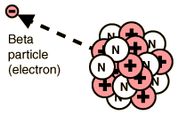

Beta Radiation Question
The diagram below shows the emission of beta radiation.
Mark Scheme
What type of particle is a beta particle?
What is the charge of a beta particle?
What material can stop beta radiation?
How far can beta radiation travel in air?

