Slide 1
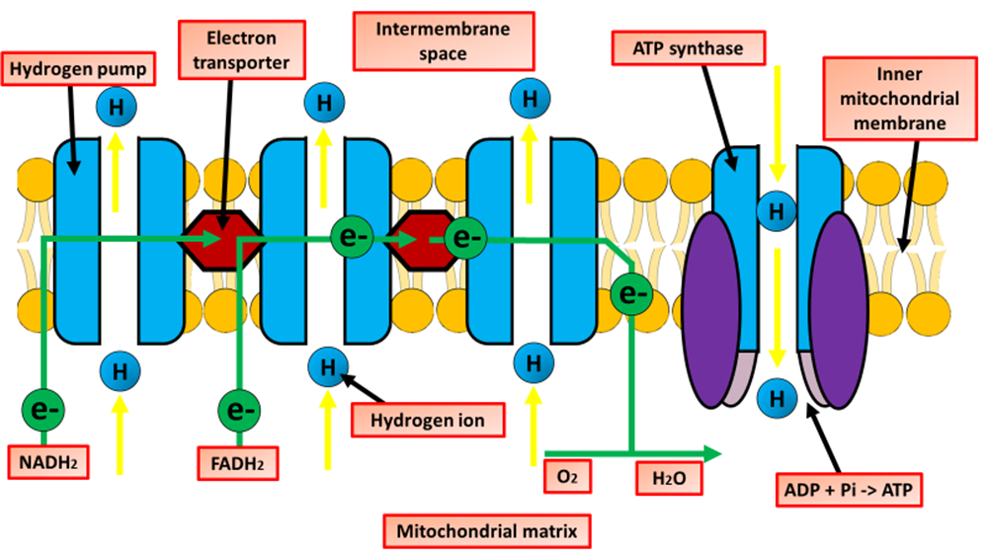
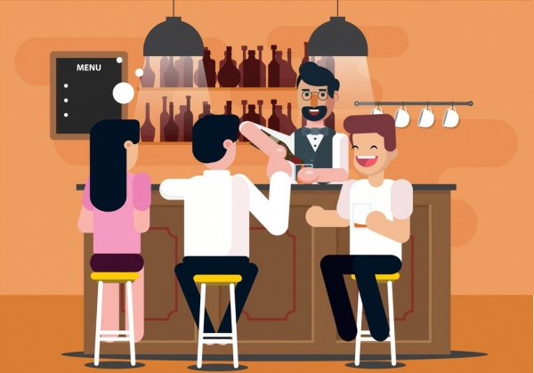
The Great Biology Pubish Quiz
Electron Transport Chains

Slide 2
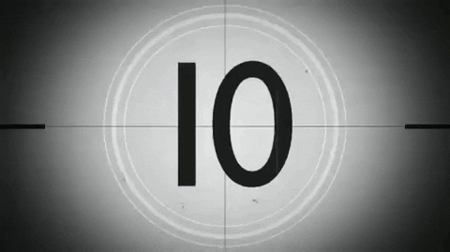
The Great Biology Pubish Quiz
Electron Transport Chains
Where does the electron transport chain (ETC) occur in eukaryotic cells?
A
Cytoplasm
Mitochondrial inner membrane
B
C
Mitochondrial outer membrane
D
Golgi apparatus

Slide 3
The Great Biology Pubish Quiz
Electron Transport Chains
What is the final electron acceptor in the mitochondrial electron transport chain?
A
Oxygen
NADH
B
C
ATP
D
Carbon dioxide

Slide 4
The Great Biology Pubish Quiz
Electron Transport Chains
Which molecule donates electrons to Complex I in the ETC?
A
FADH₂
NADH
B
C
Oxygen
D
ADP

Slide 5
The Great Biology Pubish Quiz
Electron Transport Chains
What type of phosphorylation occurs in the electron transport chain?
A
Substrate-level phosphorylation
Photophosphorylation
B
C
Oxidative phosphorylation
D
Chemiosmotic phosphorylation

Slide 6
The Great Biology Pubish Quiz
Electron Transport Chains
What enzyme produces ATP at the end of the electron transport chain?
A
ATP hydrolase
Dehydrogenase
B
C
Cytochrome oxidase
D
ATP synthase

Slide 7
The Great Biology Pubish Quiz
Electron Transport Chains
What gradient drives ATP synthesis in the ETC?
A
Sodium
B
Calcium
C
Proton
D
Chloride

Slide 8
The Great Biology Pubish Quiz
Electron Transport Chains
Question 1
B
Question 2
A
Question 3
B
Question 4
C
Question 5
D
Question 6
C

