Slide 1

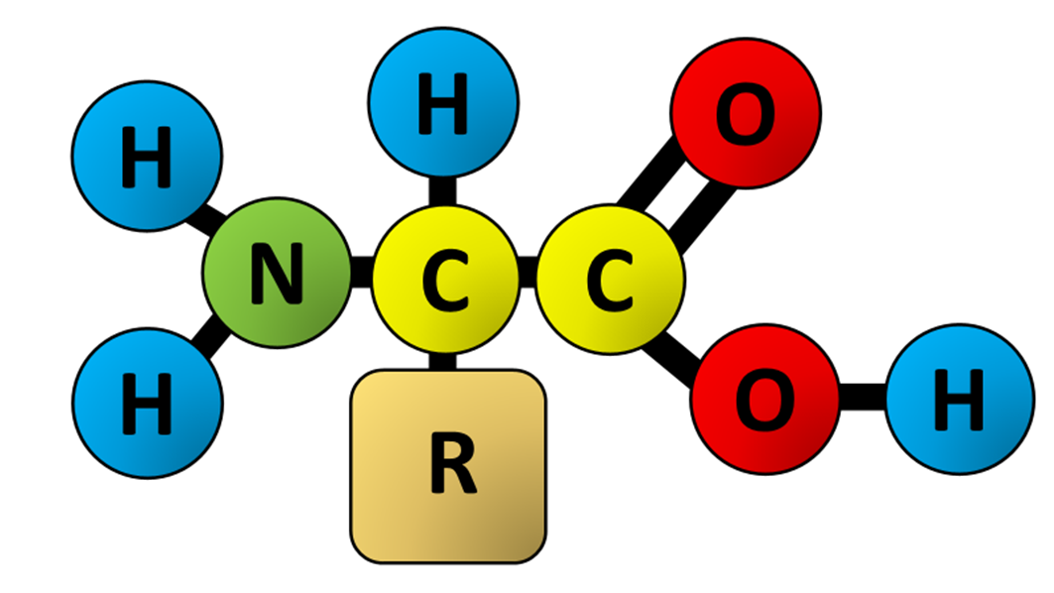

The Great Biology Pubish Quiz
Amino Acids

Slide 2

The Great Biology Pubish Quiz
Amino Acids
What are the building blocks of proteins?
A
Amino
Sugars
B
C
Amino acids
D
Lipids

Slide 3
The Great Biology Pubish Quiz
Amino Acids
What type of bond joins amino acids together?
A
Hydrogen
Peptide
B
C
Ionic
D
Covalent

Slide 4
The Great Biology Pubish Quiz
Amino Acids
How many amino acids are commonly found in proteins?
A
Ten
Twenty
B
C
Thirty
D
Fifty

Slide 5
The Great Biology Pubish Quiz
Amino Acids
What is the variable part of an amino acid called?
A
Amino
Carboxyl
B
C
R-group
D
Peptide

Slide 6
The Great Biology Pubish Quiz
Amino Acids
Which part of an amino acid contains nitrogen?
A
R-group
Amino
B
C
Carboxyl
D
Hydroxyl

Slide 7
The Great Biology Pubish Quiz
Amino Acids
What determines the function of a protein?
A
Sequence
B
Size
C
Colour
D
Shape

Slide 8

The Great Biology Pubish Quiz
Amino Acids
Question 1
C
Question 2
B
Question 3
B
Question 4
C
Question 5
B
Question 6
A

