Slide 1
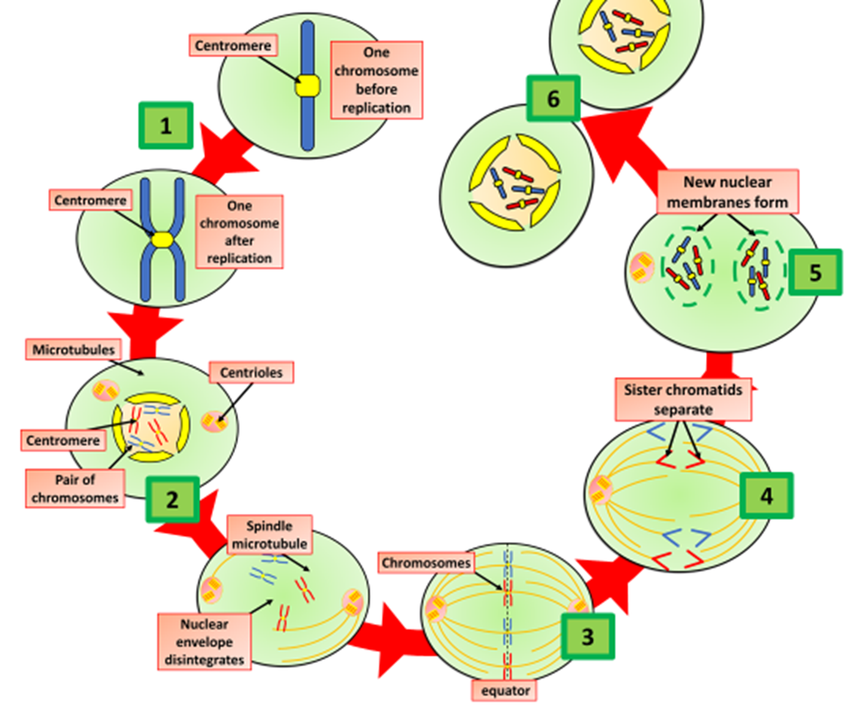
The Great Biology Pubish Quiz
Mitosis

Slide 2
The Great Biology Pubish Quiz
Mitosis
What is the main purpose of mitosis?
A
To create two genetically identical daughter cells
B
To produce genetically unique cells
C
To reduce the chromosome number by half
D
To produce gametes

Slide 3
The Great Biology Pubish Quiz
Mitosis
During which phase of mitosis do chromosomes line up along the equator of the cell?
A
Prophase
Metaphase
B
C
Anaphase
D
Telophase

Slide 4
The Great Biology Pubish Quiz
Mitosis
What happens during anaphase?
A
Chromosomes condense and become visible
B
Chromosomes align at the cell equator
C
Sister chromatids are pulled apart to opposite poles
D
The nuclear envelope reforms around the chromosomes

Slide 5
The Great Biology Pubish Quiz
Mitosis
Which of the following structures is responsible for separating sister chromatids during mitosis?
A
Nucleolus
Centrosome
B
C
Spindle fibers
D
Ribosomes

Slide 6
The Great Biology Pubish Quiz
Mitosis
In what phase of mitosis does the nuclear envelope break down?
A
Prophase
Metaphase
B
C
Anaphase
D
Telophase

Slide 7
The Great Biology Pubish Quiz
Mitosis
Which of the following accurately describes cytokinesis?
A
Division of the nucleus into two daughter nuclei
B
Division of the cytoplasm into two daughter cells
C
Condensation of chromosomes
D
Separation of homologous chromosomes

Slide 8
The Great Biology Pubish Quiz
Mitosis
Question 1
A
Question 2
B
Question 3
C
Question 4
C
Question 5
A
Question 6
B

