Slide 1
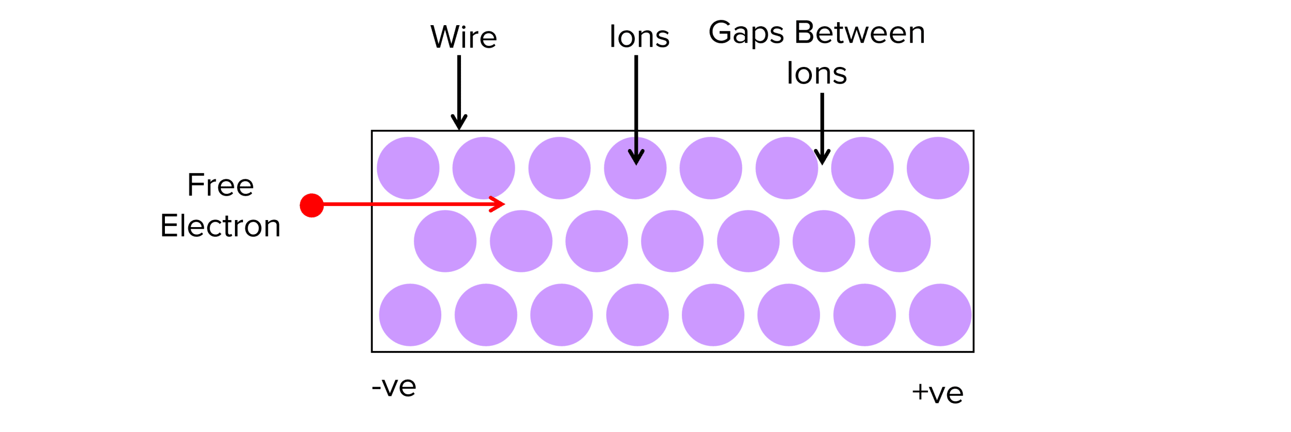

Resistance Question
The diagram below shows how electrons move through a wire. Describe how the resistance of a wire is affected by its properties.
Key things to include:
How does width affect resistance
How does length affect resistance
How does temperature affect resistance
________________________________________________________________________________________________________________________________________________________________________________________________________________________________________________________________________________________________________________________________________________________________________________________________________________________________________
Answer
Link to video

