Slide 1
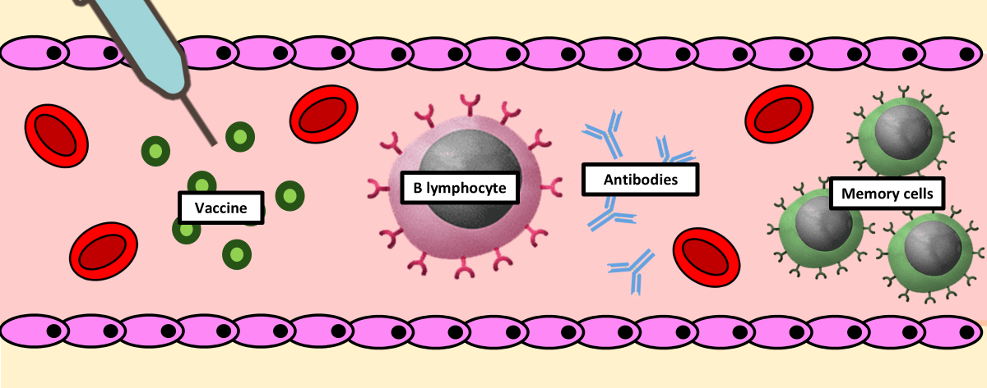
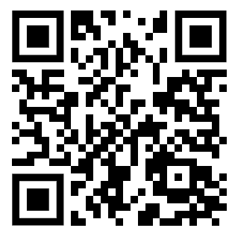
Vaccination Question
The diagram shows how vaccinations work
Video Link
What is vaccination?
What is a vaccine?
How do vaccines work?
Why are vaccines important?

