Slide 1
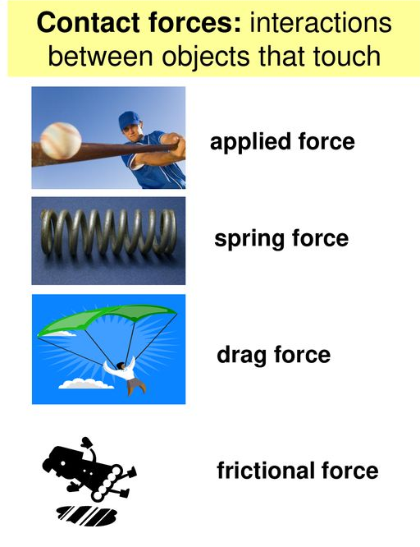
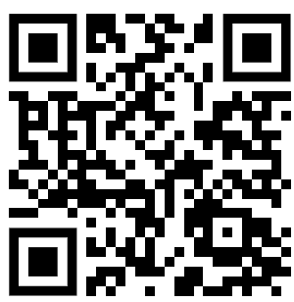
Contact Forces Question
Below are some examples of contact forces
Mark Scheme
What is a contact force?
Give one example of a contact force.
Is tension in a rope a contact or non-contact force?
What contact force opposes motion between two surfaces?

