Slide 1
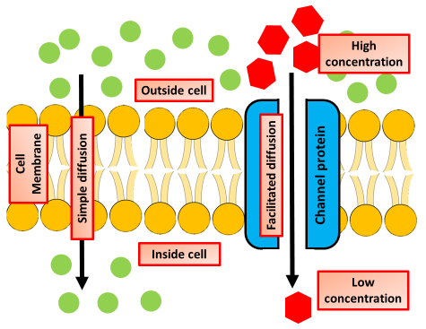

Diffusion Question
The diagram shows what happens during diffusion:
What is the movement of particles from a high concentration to a low concentration called?
Does diffusion require energy?
What gas moves into cells by diffusion for respiration?
What part of the cell allows diffusion of substances in and out?
Mark Scheme

