Slide 1



Science Competition
Science Snow Globes:
What you need to do:
Collect a snow globe template from your form tutor
Fill your snow globe with something based on science but with a Christmas theme
Make sure your name and house are written in the space below the snow globe
Hand in your completed snow globes to your Science teacher
The challenge:
Design a Christmas Snow Globe with a Science Theme

Slide 2
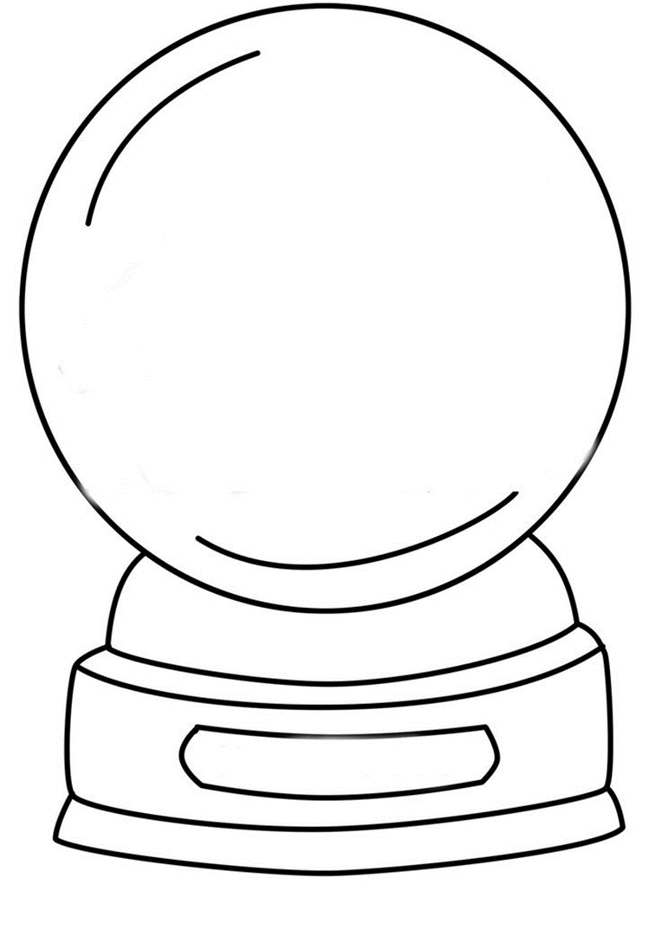

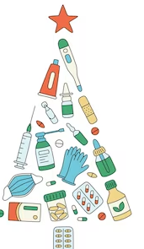


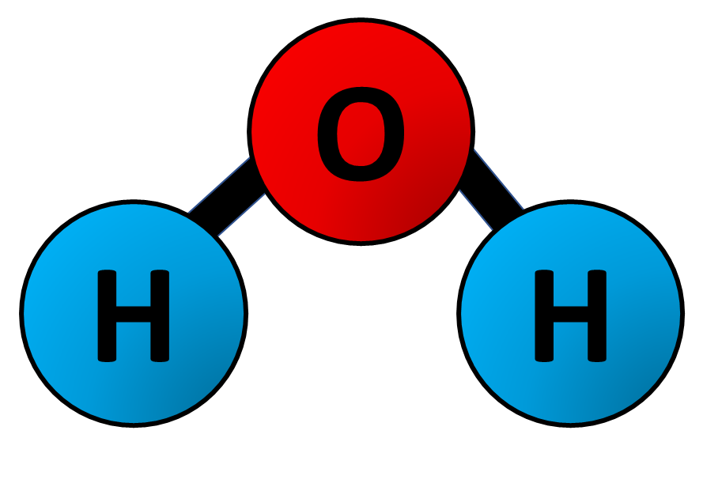

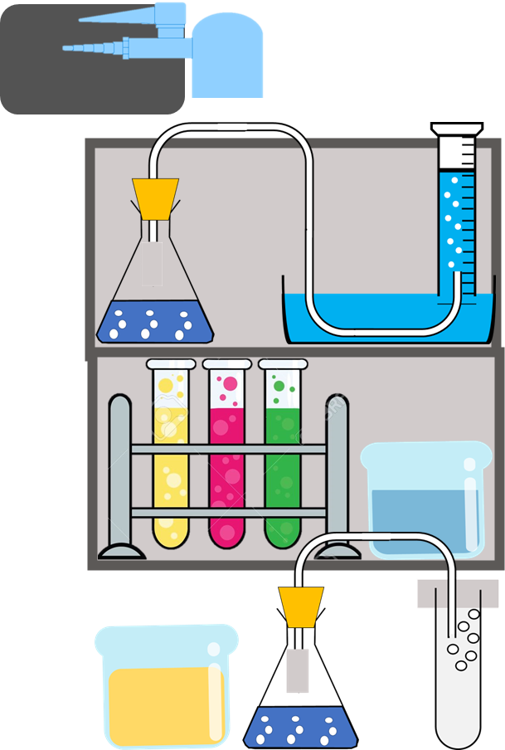
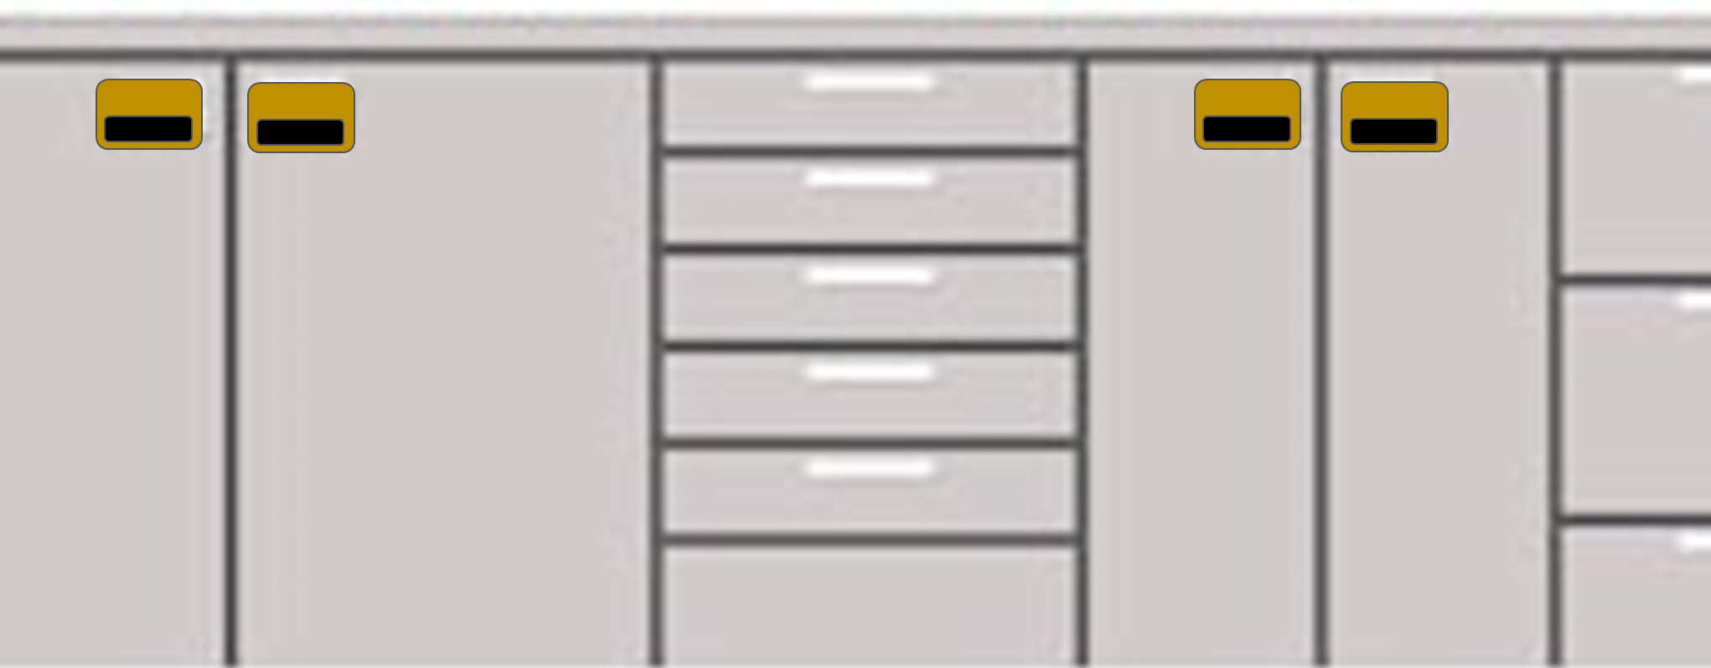
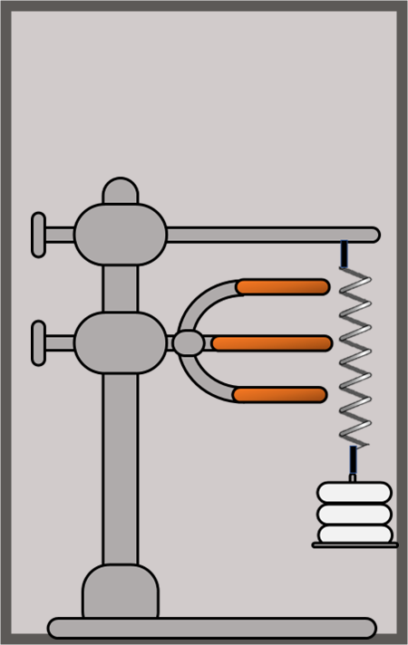
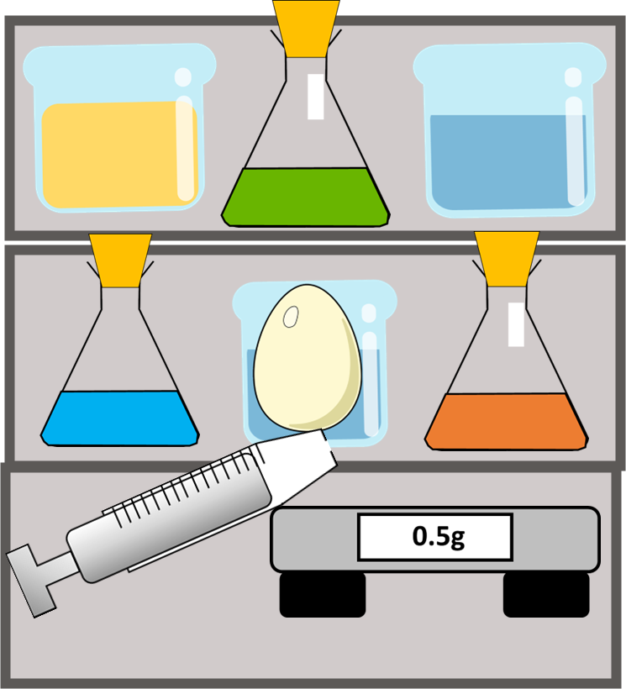
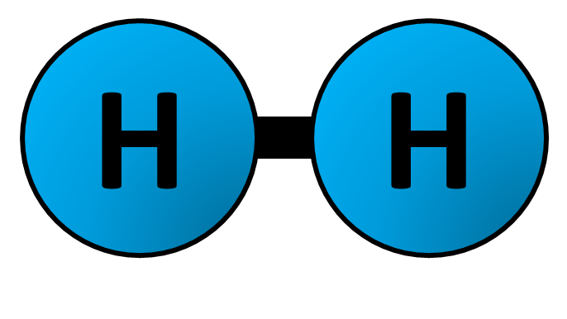

Science Competition
Science Snow Globes:
What you need to do:
Collect a snow globe template from your form tutor
Fill your snow globe with something based on science but with a Christmas theme
Make sure your name and house are written in the space below the snow globe
Hand in your completed snow globes to your Science teacher
Name & House

Slide 3


Good Luck

