Slide 1
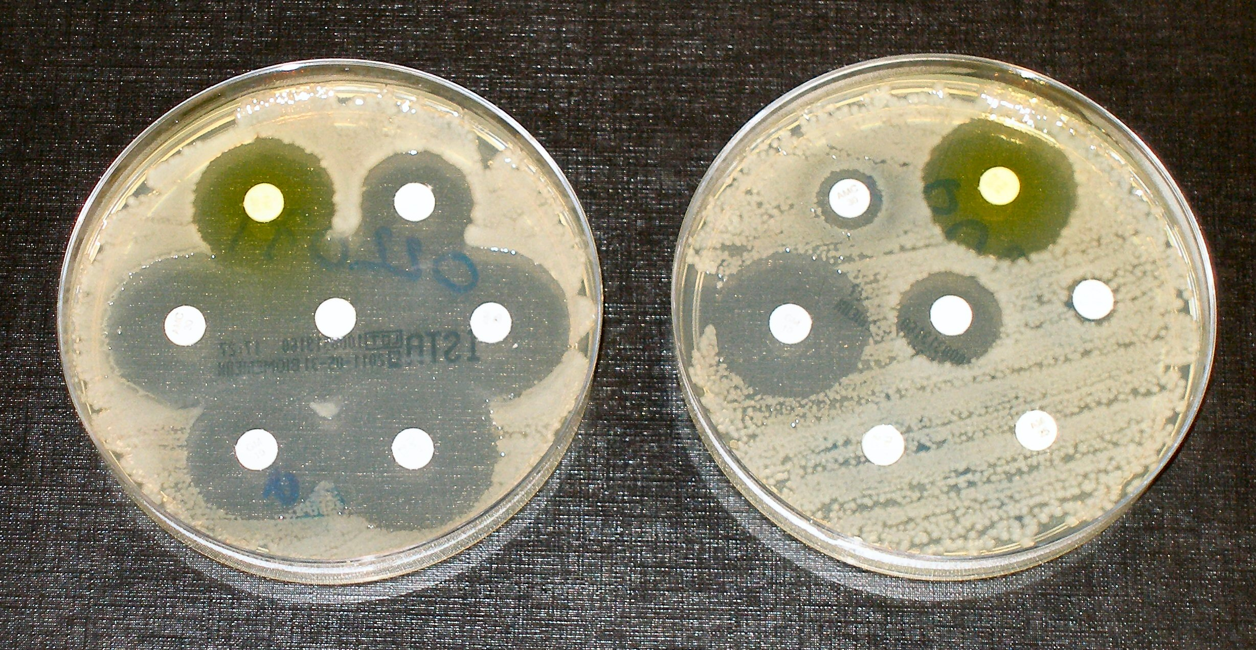

Antibiotic Resistance Question
Explain how antibiotic resistance develops in bacteria and describe one way to help reduce the spread of antibiotic-resistant bacteria.
Key things to include:
Why bacteria change
What resistance is and how is it spread
How can resistance be minimised
_______________________________________________________________________________________________________________________________________________________________________________________________________________________________________________________________________________________________________________________________________________________________________________________________________________________________________
Answer
Link to video

Slide 2

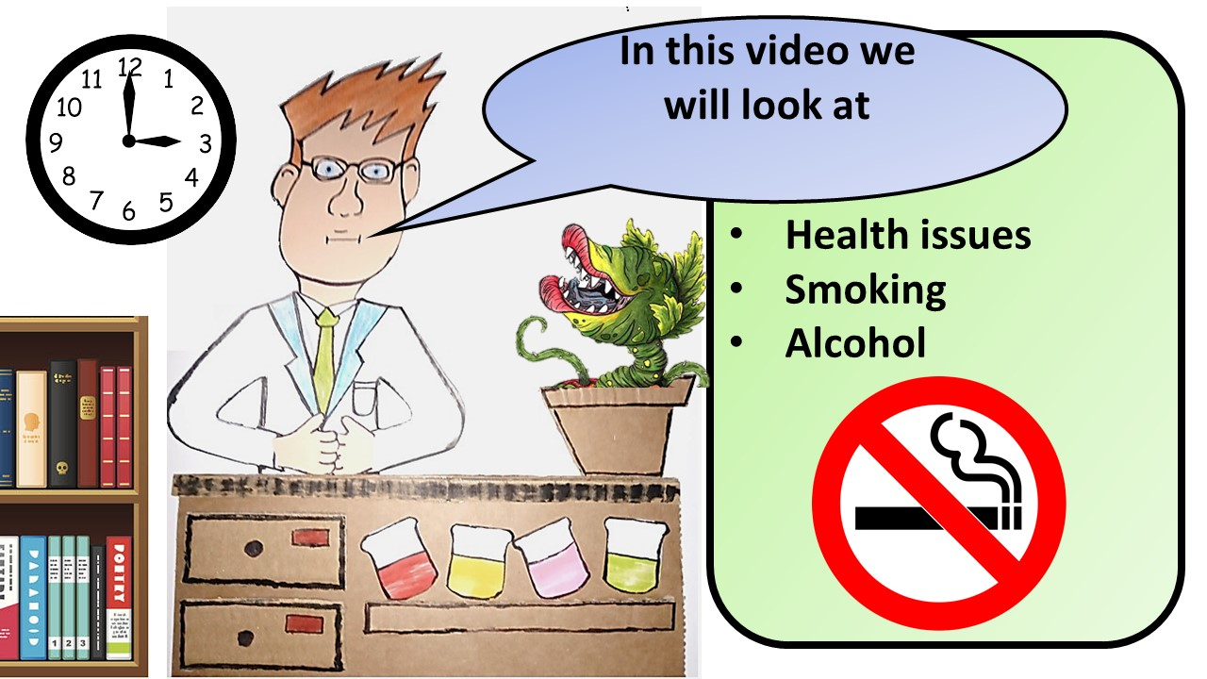


Click here to access my health youtube videos
Resources that this activity would work well with
Lesson on TES
Follow me on social media to stay in touch
Keep up to date with my new content:

