Slide 1
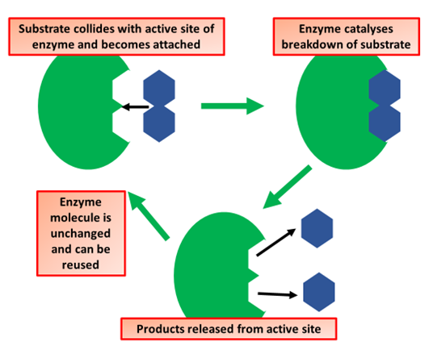

Lock & Key Question
Describe the lock and key hypothesis of enzyme action.
___________________________________________________________________________________________________________________________________________________________________________________________________________________________________________________________________________________________________________________________________________________________________________________________________________________________________________________________________________________________________________________________________________________________________________________________________________________________________
Answer
Link to video

