Slide 1
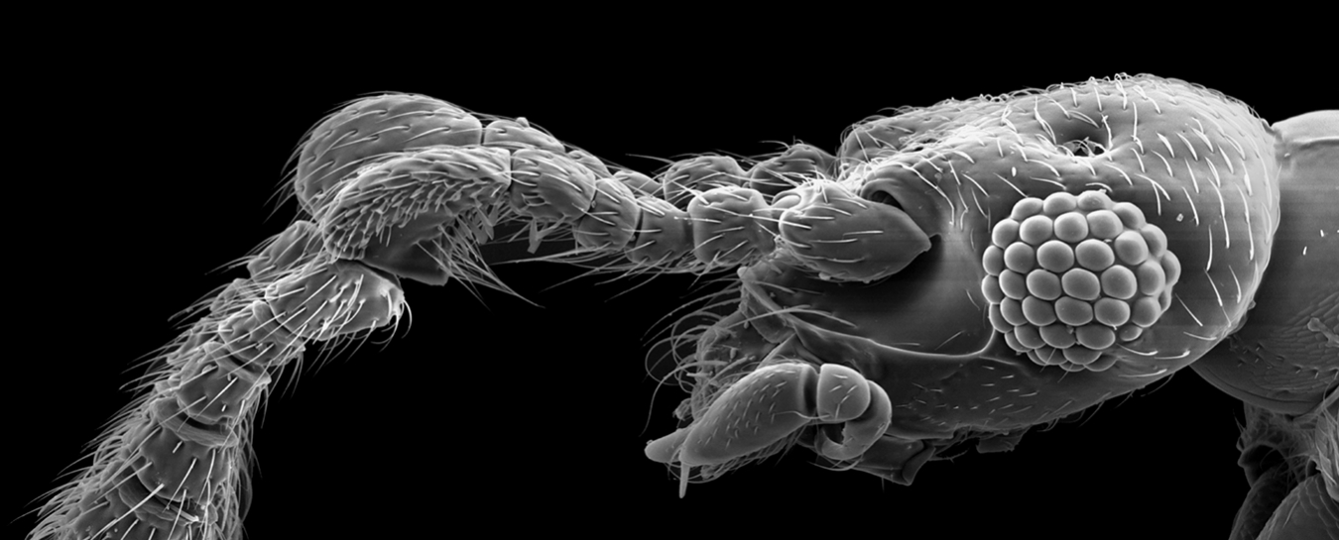

Electron Microscopes Question
Both a transmission electron microscope (TEM) and a scanning electron microscope (SEM) can be used to view the same cell. However, the images formed will be different. Describe the differences between a transmission electron microscope (TEM) and a scanning electron microscope (SEM).
____________________________________________________________________________________________________________________________________________________________________________________________________________________________________________________________________________________________________________________________________________________________________________________________________________________________________________________________________________________________________________________________________________________________________________________
Answer
Video link

