Slide 1
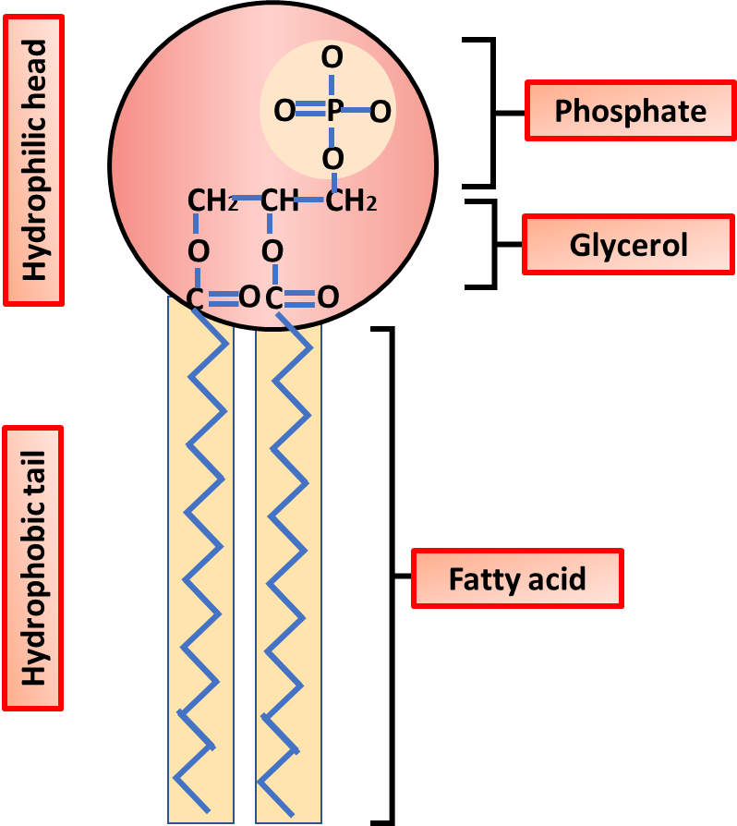

Phospholipids Question
The diagram shows the structure of a phospholipid. Describe the structure and properties of phospholipids.
____________________________________________________________________________________________________________________________________________________________________________________________________________________________________________________________________________________________________________________________________________________________________________________________________________________________________________________________________________________________________________________________________________________________________________________
Answer
Video link

