Slide 1
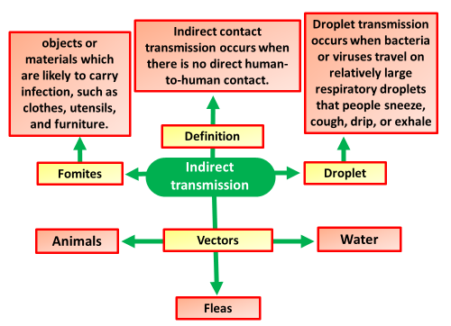

Indirect Transmission Question
Explain the process of indirect disease transmission and provide examples of how it can occur.
____________________________________________________________________________________________________________________________________________________________________________________________________________________________________________________________________________________________________________________________________________________________________________________________________________________________________________________________________________________________________________________________________________________________________________________
Answer
Video link

