Slide 1

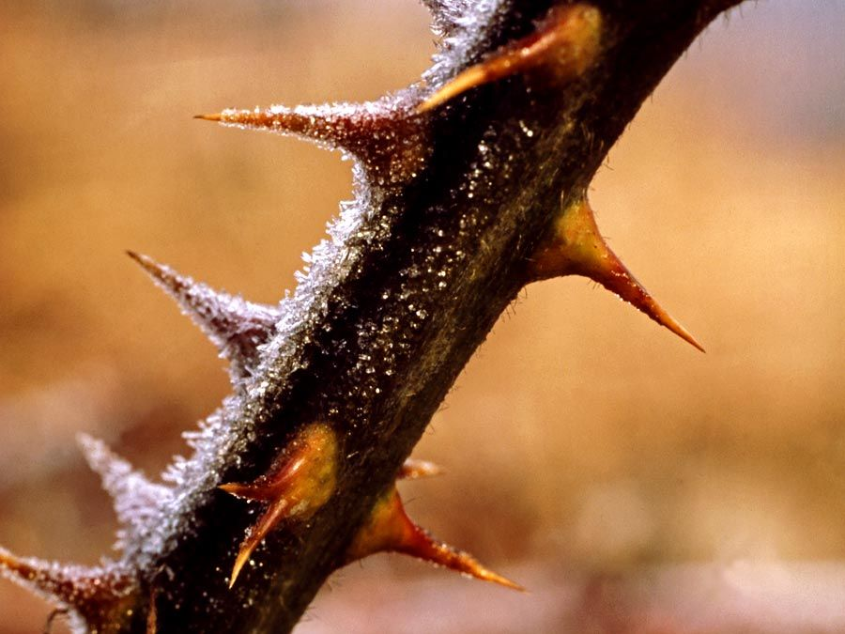

The Great Biology Pubish Quiz
Plant Defences

Slide 2

The Great Biology Pubish Quiz
Plant Defences
Which type of plant defence involves the production of toxins to deter herbivores?
A
Mechanical
Structural
B
C
Physical
D
Chemical

Slide 3
The Great Biology Pubish Quiz
Plant Defences
Which physical barrier prevents pathogens from entering plant cells?
A
Lignin
Starch
B
C
Phospholipid
D
Glycogen

Slide 4
The Great Biology Pubish Quiz
Plant Defences
Which of the following is an example of a plant chemical defence?
A
Waxy cuticle
Alkaloids
B
C
Thorns
D
Stomata closure

Slide 5
The Great Biology Pubish Quiz
Plant Defences
Which plant protein recognises pathogen molecules and triggers a defence response?
A
Phytochrome
Phytoalexins
B
C
Receptor proteins
D
Myosin

Slide 6
The Great Biology Pubish Quiz
Plant Defences
Which of the following is a structural defence against pathogens?
A
Terpenes
Callose deposition
B
C
Tannins
D
Alkaloids

Slide 7
The Great Biology Pubish Quiz
Plant Defences
What is the role of phenols in plant defence?
A
Inhibiting enzymes in herbivores
B
Preventing photosynthesis
C
Strengthening cell walls
D
Storing energy

Slide 8

The Great Biology Pubish Quiz
Plant Defences
Question 1
D
Question 2
A
Question 3
B
Question 4
C
Question 5
B
Question 6
A

