Slide 1
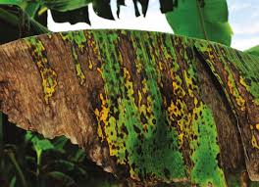

Black Sigatoka Question
Describe the cause, transmission, and effects of Black Sigatoka in banana plants
____________________________________________________________________________________________________________________________________________________________________________________________________________________________________________________________________________________________________________________________________________________________________________________________________________________________________________________________________________________________________________________________________________________________________________________
Answer
Video link

