Slide 1

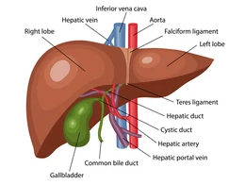

The Great Biology Pubish Quiz
Liver Structure

Slide 2

The Great Biology Pubish Quiz
Liver Structure
What is the main functional unit of the liver?
A
Lobule
Nephron
B
C
Alveolus
D
Villi

Slide 3
The Great Biology Pubish Quiz
Liver Structure
Which blood vessel brings oxygenated blood to the liver?
A
Hepatic artery
B
Hepatic vein
C
Portal vein
D
Aorta

Slide 4
The Great Biology Pubish Quiz
Liver Structure
Which vessel carries nutrient-rich blood from the digestive system to the liver?
A
Renal artery
Hepatic vein
B
C
Portal vein
D
Pulmonary vein

Slide 5
The Great Biology Pubish Quiz
Liver Structure
What cells line the sinusoids and remove bacteria and debris?
A
Islets
Neurons
B
C
Kupffer
D
Fibroblast

Slide 6
The Great Biology Pubish Quiz
Liver Structure
Which structure drains bile from the liver?
A
Ureter
Bile duct
B
C
Trachea
D
Oesophagus

Slide 7
The Great Biology Pubish Quiz
Liver Structure
Which term describes the liver’s hexagonal structural arrangement?
A
Glomerulus
B
Sacculus
C
Lobule
D
Follicle

Slide 8

The Great Biology Pubish Quiz
Liver Structure
Question 1
A
Question 2
A
Question 3
C
Question 4
C
Question 5
B
Question 6
C

