Slide 1
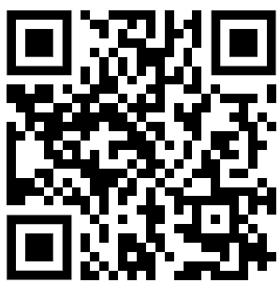
Vaccination Data Question
The table below shows the concentration of antibodies (mg/mL) in blood samples taken at different days after vaccination.
Analyse the data and explain what it shows about the immune response after vaccination.
Day after vaccination | Antibody concentration (mg/mL)
0 | 0.1
3 | 0.5
7 | 2.0
14 | 5.5
21 | 4.8
28 | 3.0
______________________________________________________________________________________________________________________________________________________________________________________________________________________________________________________________________________________________________________________________________________________________________________________________________________________________________________________________________________________
Answer
Link to video

