Slide 1
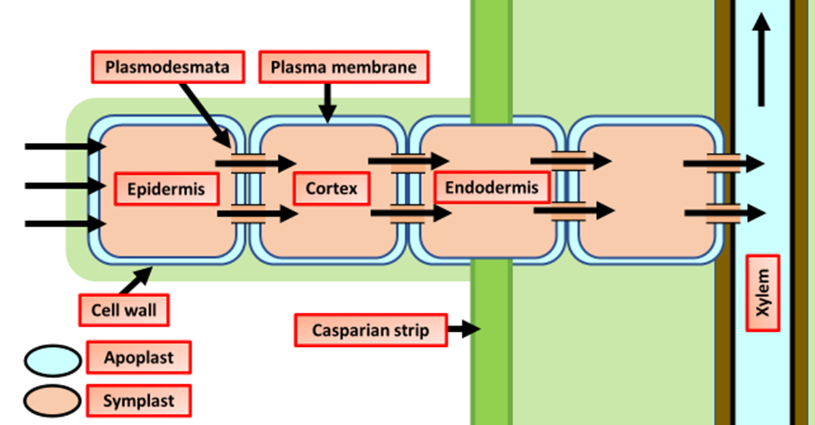

Symplast Pathway Question
The diagram below shows how water enters the plant. Describe how water moves through a plant via the symplast pathway.
____________________________________________________________________________________________________________________________________________________________________________________________________________________________________________________________________________________________________________________________________________________________________________________________________________________________________________________________________________________________________________________________________________________________________________________
Answer
Video link

