Slide 1

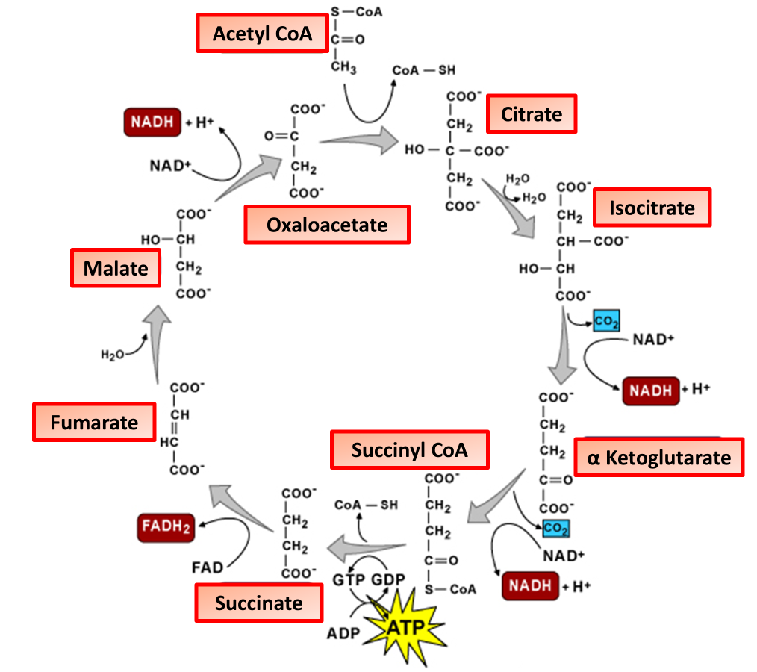

The Great Biology Pubish Quiz
Krebs Cycle

Slide 2

The Great Biology Pubish Quiz
Krebs Cycle
Where does the Krebs cycle take place?
A
Matrix
Cytoplasm
B
C
Cristae
D
Nucleus

Slide 3
The Great Biology Pubish Quiz
Krebs Cycle
Which molecule enters the Krebs cycle by combining with oxaloacetate?
A
Pyruvate
B
Glucose
C
Lactate
D
Acetyl-CoA

Slide 4
The Great Biology Pubish Quiz
Krebs Cycle
How many turns of the Krebs cycle occur per glucose molecule?
A
One
Two
B
C
Three
D
Four

Slide 5
The Great Biology Pubish Quiz
Krebs Cycle
What is the first stable compound formed in the Krebs cycle?
A
Citrate
Malate
B
C
Fumarate
D
Succinate

Slide 6
The Great Biology Pubish Quiz
Krebs Cycle
Which of these is produced during the Krebs cycle?
A
Oxygen
Ethanol
B
C
NADH
D
Glucose

Slide 7
The Great Biology Pubish Quiz
Krebs Cycle
Which gas is released during the Krebs cycle?
A
Oxygen
B
Nitrogen
C
Carbon dioxide
D
Hydrogen

Slide 8

The Great Biology Pubish Quiz
Krebs Cycle
Question 1
A
Question 2
D
Question 3
B
Question 4
A
Question 5
C
Question 6
C

