Slide 1
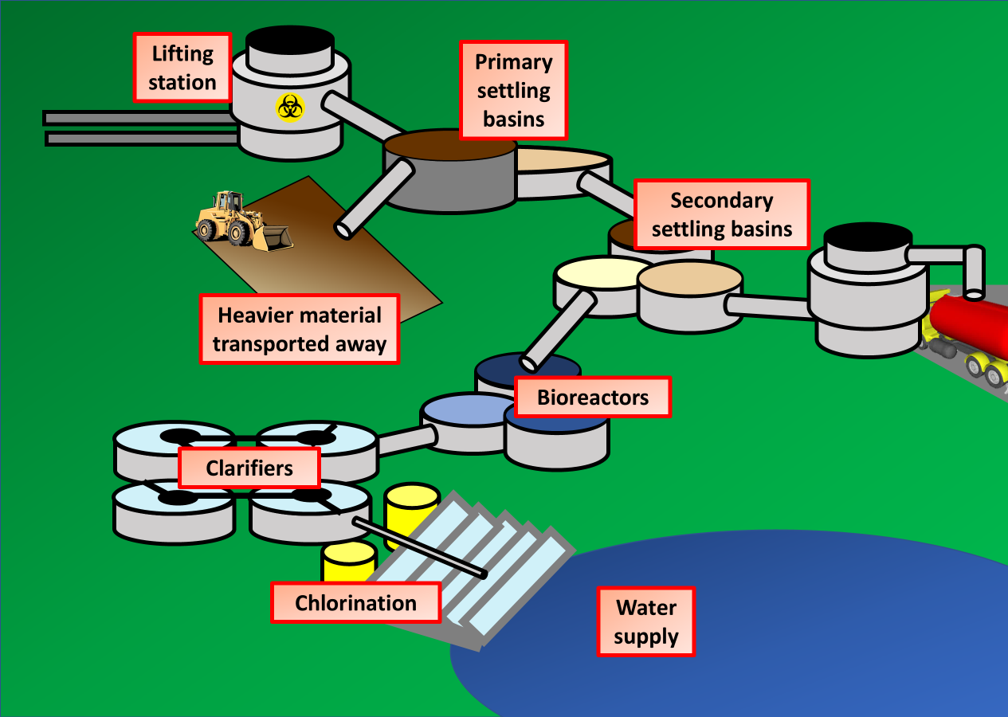
Waste Water Treatment Question
The diagram below shows the stages of water treatment
Describe the key stages in the treatment of wastewater.
Key things to include:
What happens during primary treatment
What happens during secondary treatment
_______________________________________________________________________________________________________________________________________________________________________________________________________________________________________________________________________________________________________________________________________________________________________________________________________________________________________
Answer
Link to video

