Slide 1

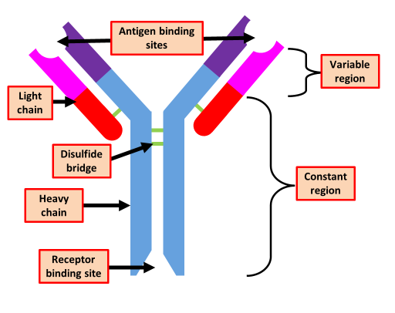

The Great Biology Pubish Quiz
Antibodies

Slide 2

The Great Biology Pubish Quiz
Antibodies
What part of the antibody binds specifically to an antigen?
A
Constant region
Variable region
B
C
Hinge region
D
Disulfide bridge

Slide 3
The Great Biology Pubish Quiz
Antibodies
Which type of cell produces antibodies?
A
Helper T cells
Cytotoxic T cells
B
C
Plasma B cells
D
Memory B cells

Slide 4
The Great Biology Pubish Quiz
Antibodies
What holds the polypeptide chains of an antibody together?
A
Hydrogen bonds
Peptide bonds
B
C
Ionic bonds
D
Disulfide bonds

Slide 5
The Great Biology Pubish Quiz
Antibodies
What is the function of the constant region of an antibody?
A
To bind to antigens
To activate B cells
B
C
To attach to immune cells
D
To destroy pathogens directly

Slide 6
The Great Biology Pubish Quiz
Antibodies
Which of the following describes agglutination?
A
Clumping of pathogens by antibodies
Binding of antibodies to toxins
B
C
Activation of T cells by B cells
D
Release of histamine during inflammation

Slide 7
Complement protein
The Great Biology Pubish Quiz
Antibodies
What is formed when an antibody binds to an antigen?
A
Complement protein
B
Antigen-antibody complex
C
Plasma cell
D
Memory cell

Slide 8

The Great Biology Pubish Quiz
Antibodies
Question 1
B
Question 2
C
Question 3
D
Question 4
C
Question 5
A
Question 6
D

