Slide 1
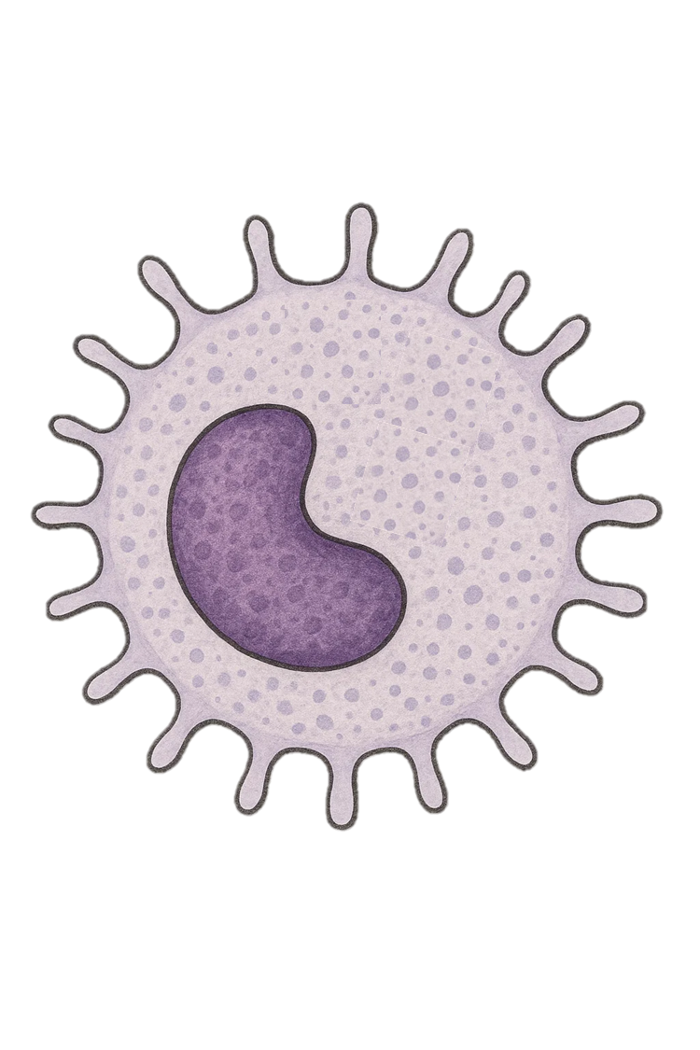
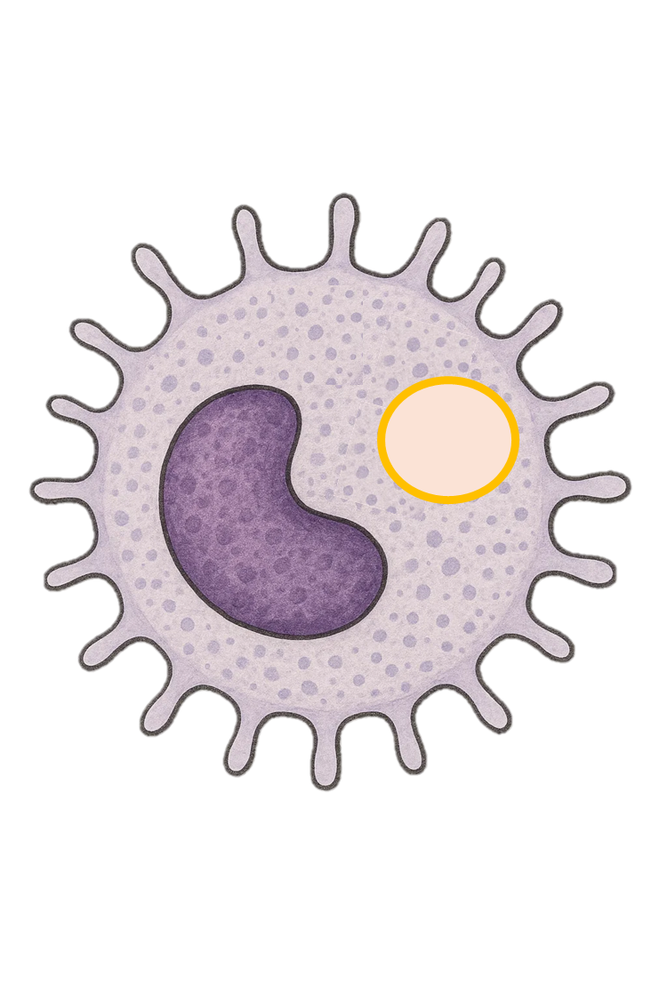
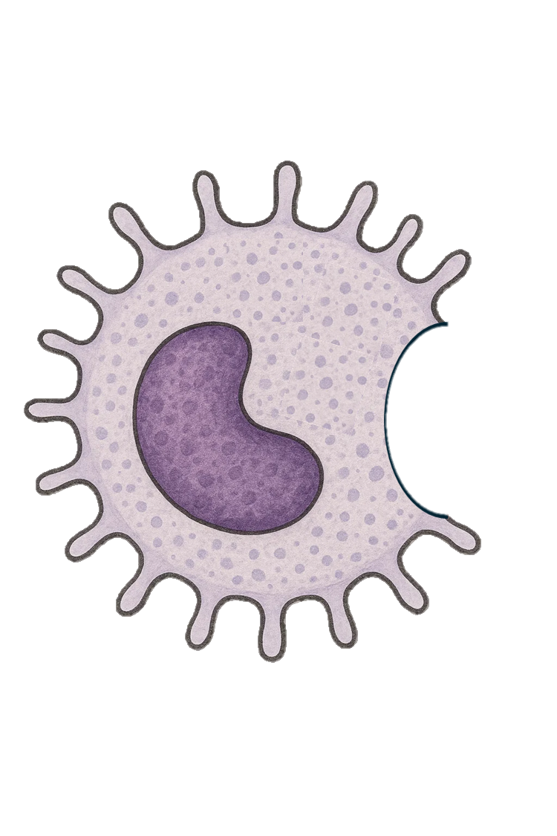

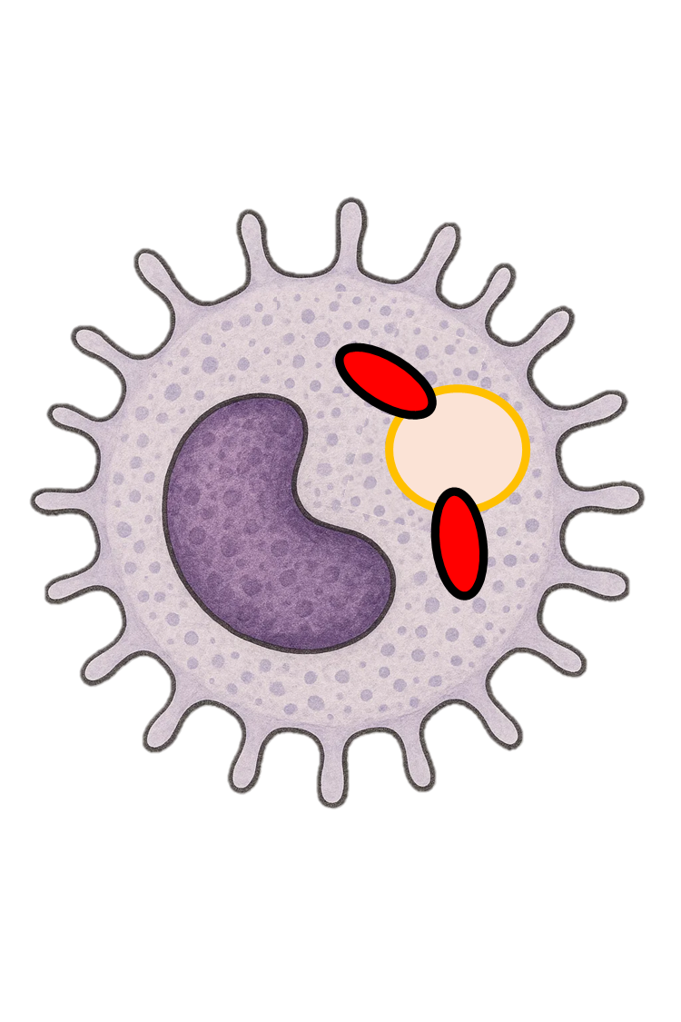
Phagocytosis
5: Once the pathogen has been broken down, what happens to what’s left over?
4: How does the phagocyte break down the pathogen?
1: How does the phagocyte recognise the pathogen?
2: How does the phagocyte recognise the pathogen?
1: Detection of the pathogen – A white blood cell (phagocyte) recognises harmful microorganisms such as bacteria in the body.
3: What happens as the phagocyte engulfs the pathogen
3: Engulfing the pathogen – The phagocyte surrounds the pathogen with its cell membrane and traps it inside a sac called a phagosome.
4: Digestion – Enzymes are released into the phagosome, breaking down and destroying the pathogen.
5: Removal of waste – Any harmless waste products are removed from the cell, helping prevent further infection.
2: Movement toward the pathogen – The phagocyte moves toward the pathogen by following chemical signals it releases.

Slide 2
Phagocytosis
5: Removal of waste –
1: Detection of the pathogen –
3: Engulfing the pathogen –
2: Movement toward the pathogen –
4: Digestion –

