Slide 1
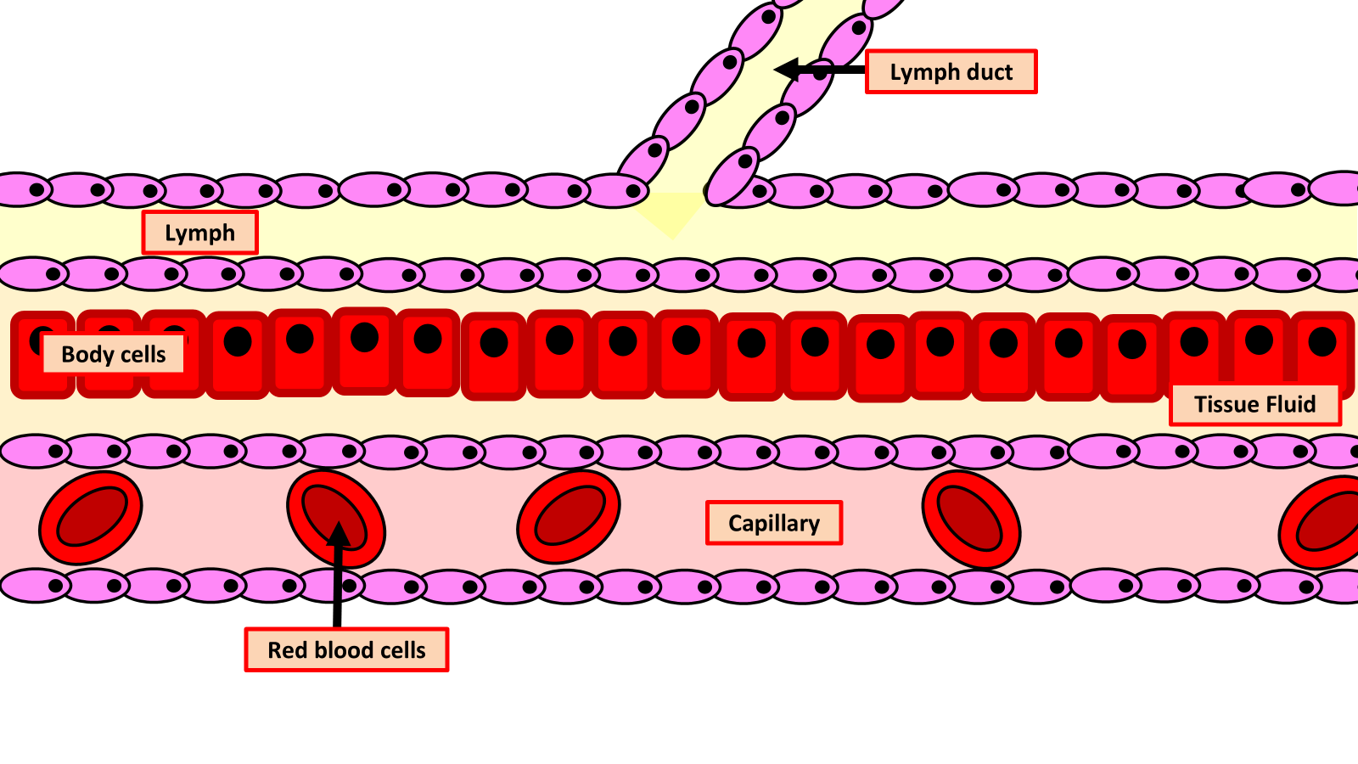

Tissue Fluid Question
The diagram below shows how tissue fluid forms
Explain how tissue fluid is formed at the arteriole end of a capillary and how it is reabsorbed at the venule end.
________________________________________________________________________________________________________________________________________________________________________________________________________________________________________________________________________________________________________________________________________________________________________________________________________________________________________________________________________________________________________________________________________________________________________________________________________________________________________________________________________________________________________________________________________________________________________________
Answer
Link to video

