Slide 1
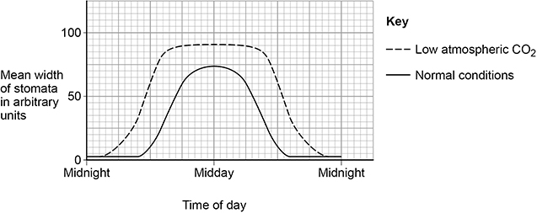

Stomata Practice Question
The figure below shows information about the mean width of the stomata in a plant.
The changes in the mean width of the stomata in normal conditions are an advantage to the plant. Explain how.
Key things to include:
The role of stomata
The effect of light on photosynthesis
The effect of carbon dioxide on photosynthesis
______________________________________________________________________________________________________________________________________________________________________________________________________________________________________________________________________________________________________________________________________________________________________________________________________________________________________________________________________________________
Answer
Link to video

Slide 2
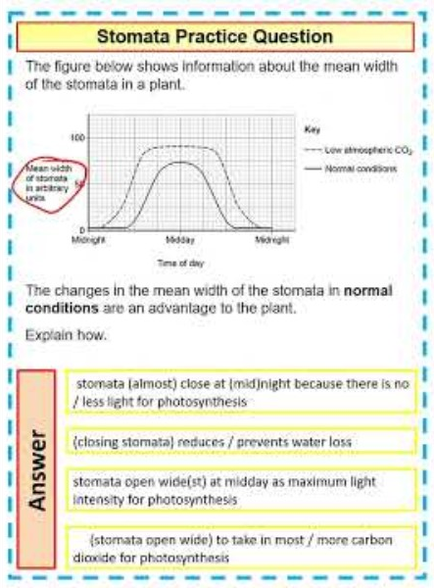
Stomata Practice Question

