Slide 1
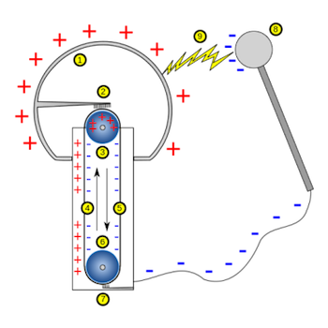

Static Electricity Practice Question
A negatively charged rod is held near an earthed conductor.
Explain why a spark jumps between the negatively charged rod and the earthed conductor.
Key things to include:
The size of the potential difference
How the electrons move and why
Answer
_________________________________________________________________________________________________________________________________________________________________________________________________________________________________________________________________________________________________________________________________________
Link to video

Slide 2
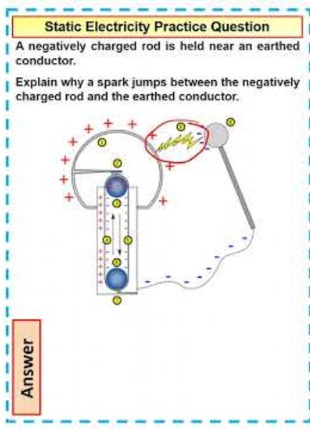
Static Electricity Practice Question

