Slide 1

Alcohol & Liver Cirrhosis Question
Consuming alcohol with meals instead of not with meals decreases the relative risk of developing cirrhosis of the liver. Cirrhosis of the liver leads to liver failure.
Describe the effects of liver failure on the human body.
Key things to include:
What the role of the liver is
How the liver stores glucose
The role of bile
How the liver breaks down excess amino acids
_________________________________________________________________________________________________________________________________________________________________________________________________________________________________________________________________________________________________________________________________________________________________________________________________________________________________________________________________________________________________________________________________________________________________________________________________________________________________________________________________________
Answer
Link to video

Slide 2
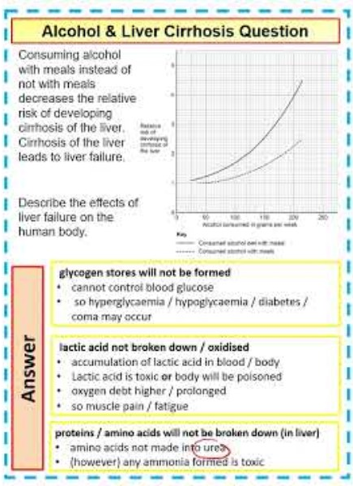
Alcohol & Liver Cirrhosis Question

