Slide 1
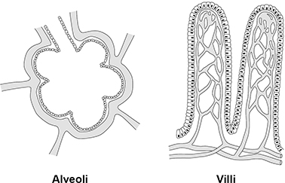

Exchange of Materials Question
Organism D and organism E both have alveoli in the lungs and villi in the small intestine. The figure below shows some alveoli and some villi.
Describe how the alveoli and the villi are adapted to increase absorption.
Key things to include:
How is surface area affected
How is diffusion distance reduced
What is the role of a good blood supply
What is the role of mitochondria in villi
______________________________________________________________________________________________________________________________________________________________________________________________________________________________________________________________________________________________________________________________________________________________________________________________________________________________________________________________________________________
Answer
Link to video

Slide 2
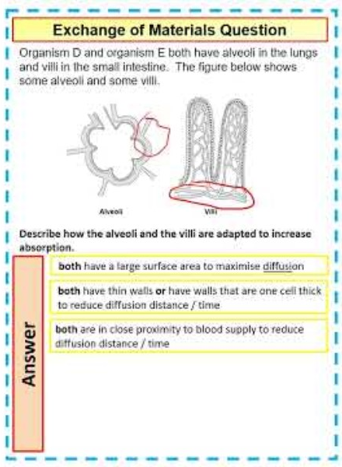
Exchange of Materials Question

Slide 3

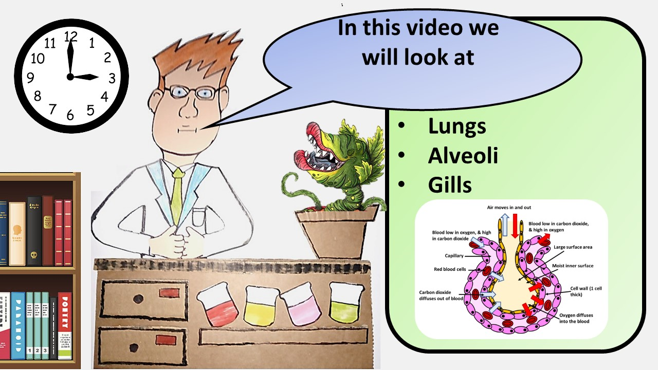


Click here to access my youtube videos
Resources that this activity would work well with
Lesson on TES
Lesson on TPT
Follow me on social media to stay in touch
Keep up to date with my new content:

