Slide 1
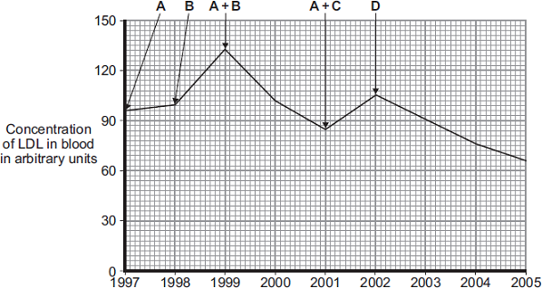

Statins Question
LDL is one form of cholesterol found in the blood. People with a high concentration of LDL in their blood may be treated with drugs called statins. The graph shows the effects of the treatment of one person with four different statins, A, B, C and D, over a period of 8 years. The arrows show when each new treatment was started.
Compare the effectiveness of the five treatments in reducing the risk of heart and circulatory diseases for this person.
____________________________________________________________________________________________________________________________________________________________________________________________________________________________________
Answer
Link to video

Slide 2
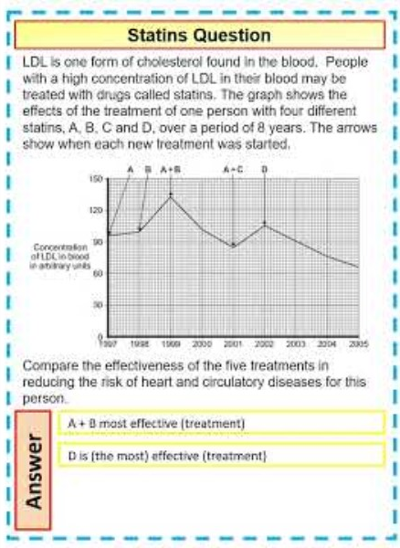
Statins Question

Slide 3

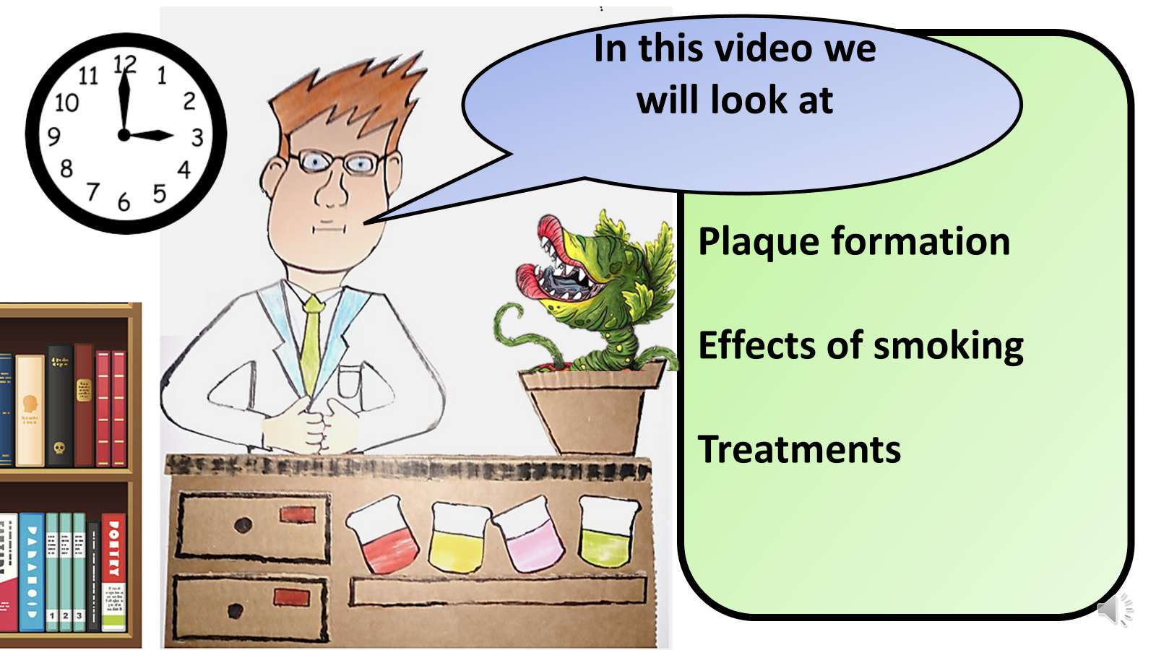


Click here to access my youtube videos
Resources that this activity would work well with
Lesson on TES
Lesson on TPT
Follow me on social media to stay in touch
Keep up to date with my new content:

