Slide 1
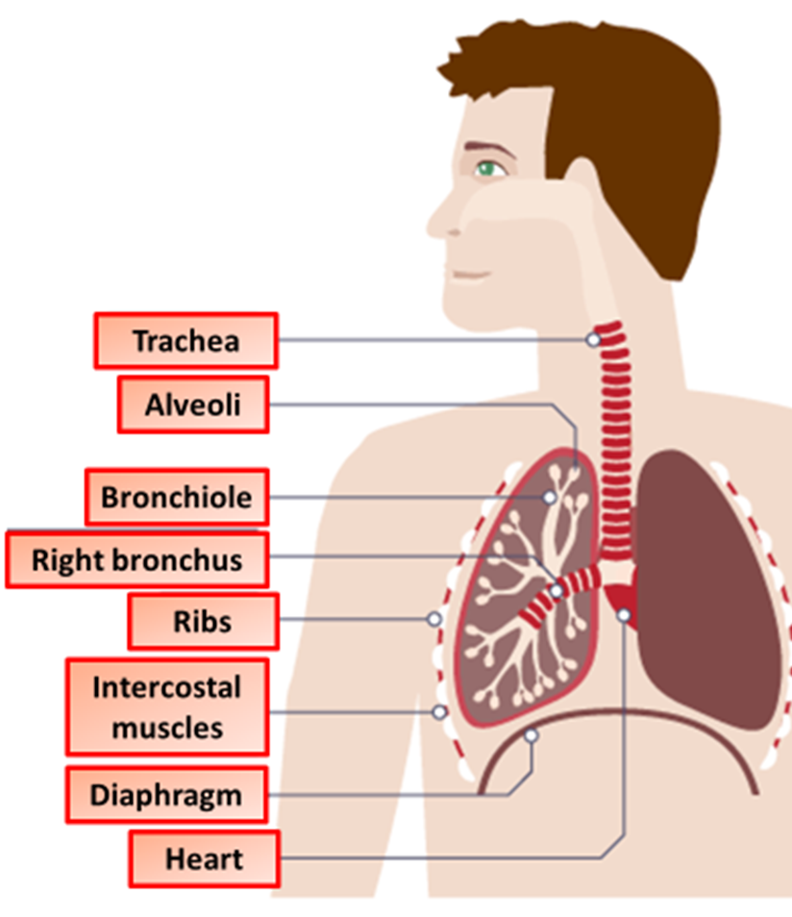

Effects of Exercise Question
The diagram below shows some of the body organs affected by exercise
Video Link
What happens to heart rate during exercise?
Why does breathing rate increase during exercise?
What waste product builds up in muscles during anaerobic respiration?
Why do muscles feel tired after intense exercise?

