Slide 1

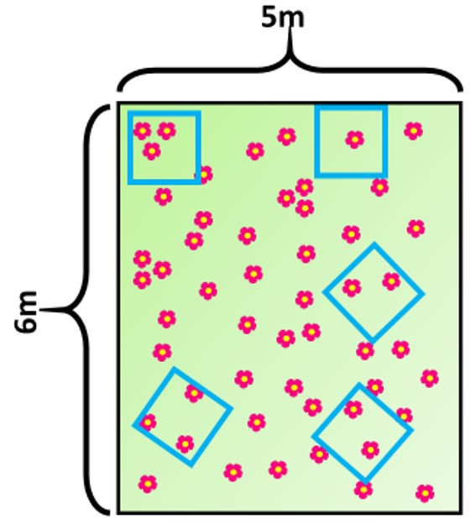

The Great Biology Pubish Quiz
Sampling Techniques

Slide 2

The Great Biology Pubish Quiz
Sampling Techniques
What is the main purpose of random sampling in ecology?
A
To increase biodiversity
To ensure an unbiased representation of a population
B
C
To target the most common species
D
To avoid measuring abiotic factors

Slide 3
The Great Biology Pubish Quiz
Sampling Techniques
Which tool is commonly used for sampling plant abundance in a habitat?
A
Pitfall trap
Quadrat
B
C
Sweep net
D
Tullgren funnel

Slide 4
The Great Biology Pubish Quiz
Sampling Techniques
What is the purpose of using a transect in ecological sampling?
A
To count animals in a forest
To locate endangered species
B
C
To observe how species distribution changes across a gradient
D
To identify species using DNA

Slide 5
The Great Biology Pubish Quiz
Sampling Techniques
What type of sampling involves placing quadrats at regular intervals along a line?
A
Stratified sampling
Random sampling
B
C
Systematic sampling
D
Opportunistic sampling

Slide 6
The Great Biology Pubish Quiz
Sampling Techniques
Which of the following is a key assumption of the mark-release-recapture method?
A
All individuals can be tracked electronically
No immigration or emigration occurs between samples
B
C
Animals become easier to catch after marking
D
Only rare species are studied

Slide 7
The Great Biology Pubish Quiz
Sampling Techniques
What is the main purpose of stratified sampling?
A
To ensure equal numbers of all species are counted
B
To sample only dominant species
C
To reflect known proportions of different habitat types
D
To avoid sampling rare habitats

Slide 8

The Great Biology Pubish Quiz
Sampling Techniques
Question 1
B
Question 2
B
Question 3
C
Question 4
C
Question 5
B
Question 6
C

