Slide 1
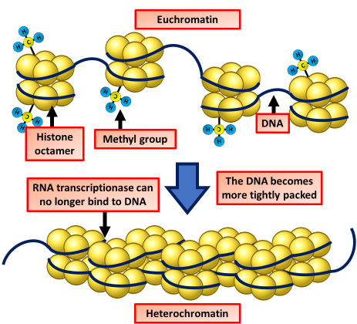

Heterochromatin Control Question
Explain the role of heterochromatin in the control of gene expression.
____________________________________________________________________________________________________________________________________________________________________________________________________________________________________________________________________________________________________________________________________________________________________________________________________________________________________________________________________________________________________________________________________________________________________________________
Answer
Video link

