Slide 1


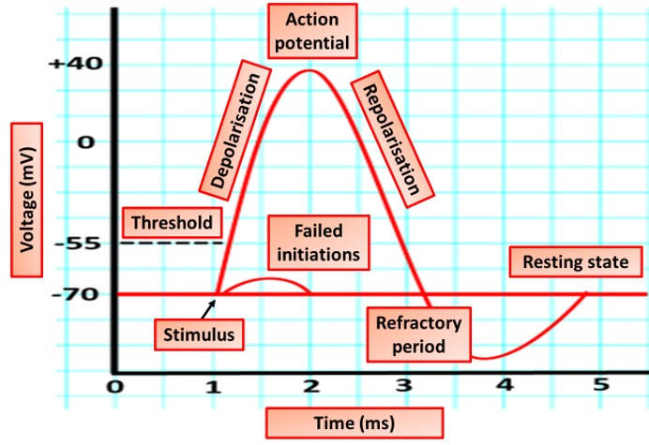

Biology Question
You have 5 seconds to look at the diagram below

Slide 2



Biology Question
What is the typical resting membrane potential of a neuron?
A
+70mV
B
-70mV
C
55mV
D
-10mV

Slide 3
Biology Question
During an action potential, which ion channels open first when the threshold is reached?
A
Sodium (Na⁺) channels
B
Potassium (K⁺) channels
C
Chloride (Cl⁻) channels
D
Calcium (Ca²⁺)

Slide 4
Biology Question
What term describes the period when a neuron cannot fire another action potential, no matter how strong the stimulus?
A
Relative refractory period
B
Depolarisation
C
Hyperpolarisation
D
Absolute refractory period

Slide 5
Biology Question
Which process restores the membrane potential to a more negative value after the peak of an action potential?
A
Depolarisation
B
Hyperpolarisation
C
Repolarisation
D
Threshold potential

Slide 6
Biology Question
What causes the rapid depolarization phase of the action potential?
A
Influx of potassium ions (K⁺)
B
Efflux of sodium ions (Na⁺)
C
Influx of sodium ions (Na⁺)
D
Efflux of calcium ions (Ca²⁺)

Slide 7
Biology Question
What sort of protein channels open in the axon membrane as the action potential is propagated?
A
Voltage-gated potassium channel
B
Ligand-gated sodium ion channel
C
Potassium leak channel
D
Voltage gated sodium ion channel

