Slide 1


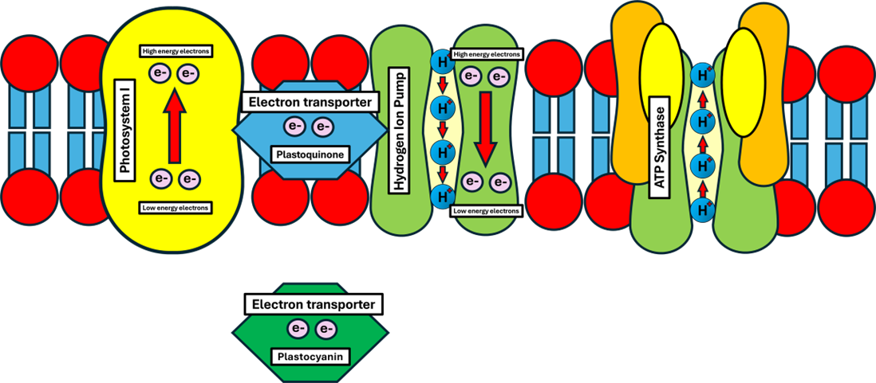
The Great Biology Pubish Quiz
Light Dependent Photosynthesis

Slide 2

The Great Biology Pubish Quiz
Light Dependent Photosynthesis
Where do the light-dependent reactions of photosynthesis take place?
A
Stroma
Thylakoid membrane
B
C
Cytoplasm
D
Matrix

Slide 3
The Great Biology Pubish Quiz
Light Dependent Photosynthesis
What is the primary role of chlorophyll in the light-dependent reactions?
A
To fix carbon dioxide
To absorb light energy
B
C
To produce glucose
D
To release oxygen

Slide 4
The Great Biology Pubish Quiz
Light Dependent Photosynthesis
Which enzyme is responsible for ATP production in the light-dependent reactions?
A
RuBisCO
Cristase
B
C
ATP Synthase
D
Lamellasa

Slide 5
The Great Biology Pubish Quiz
Light Dependent Photosynthesis
What is the final electron acceptor in the light-dependent reactions?
A
Oxygen
NADP⁺
B
C
ADP
D
Glucose

Slide 6
The Great Biology Pubish Quiz
Light Dependent Photosynthesis
Which enzyme is responsible for ATP production in the light-dependent reactions?
A
RuBisCO
ATP synthase
B
C
NADP reductase
D
Phosphofructokinase

Slide 7
The Great Biology Pubish Quiz
Light Dependent Photosynthesis
What is the function of the electron transport chain in the light-dependent reactions?
A
To generate oxygen
B
To produce ATP and NADPH
C
To fix carbon dioxide
D
To break down glucose

Slide 8

The Great Biology Pubish Quiz
Light Dependent Photosynthesis
Question 1
B
Question 2
B
Question 3
C
Question 4
B
Question 5
B
Question 6
B

