Slide 1
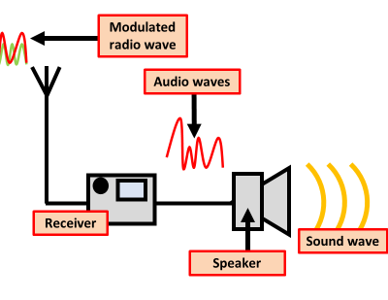

Receiving Radio Waves Question
Describe how radio waves are converted back into sound in a radio receiver.
Key things to include:
What are radio waves
How are radio waves converted into a AC current
How is an AC current converted into sound
_______________________________________________________________________________________________________________________________________________________________________________________________________________________________________________________________________________________________________________________________________________________________________________________________________________________________________
Answer
Link to video

