Slide 1
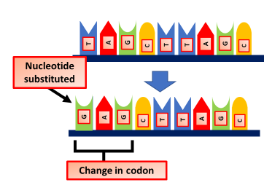

Frame Shift Mutations Question
Explain how a frameshift mutation can affect the protein produced.
____________________________________________________________________________________________________________________________________________________________________________________________________________________________________________________________________________________________________________________________________________________________________________________________________________________________________________________________________________________________________________________________________________________________________________________
Answer
Video link

