Slide 1
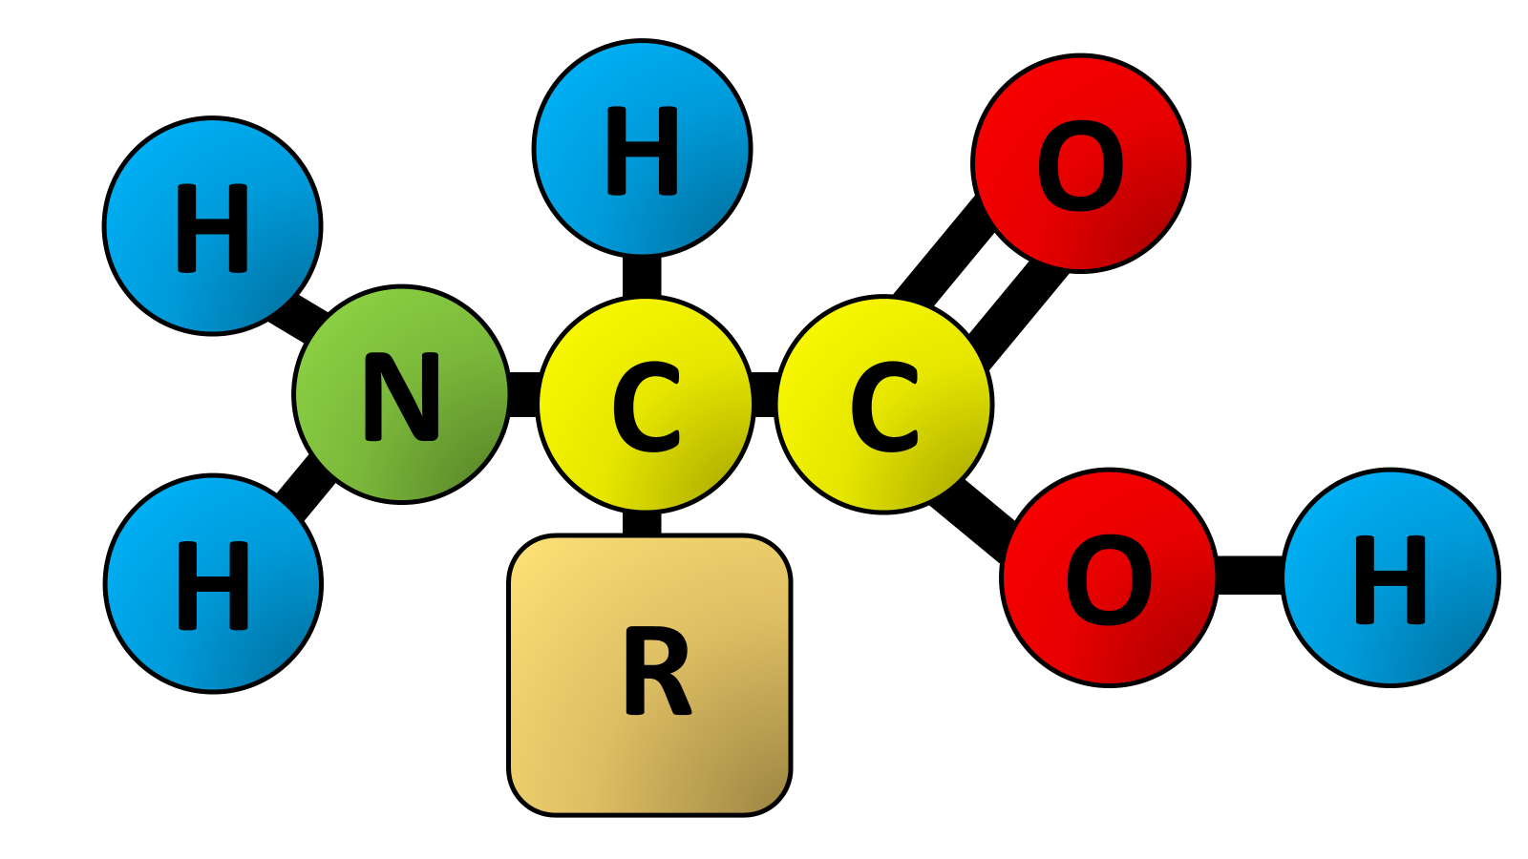

Amino Acids Question
Describe the structure of an amino acid and explain how its properties enable the formation of proteins with specific shapes and functions.
____________________________________________________________________________________________________________________________________________________________________________________________________________________________________________________________________________________________________________________________________________________________________________________________________________________________________________________________________________________________________________________________________________________________________________________
Answer
Video link

