Slide 1
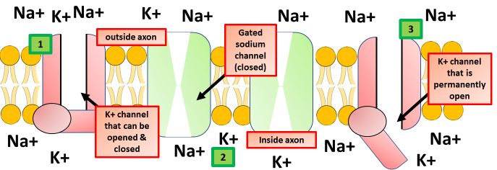
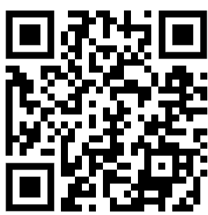
Action Potential Question
Describe the key events that occur during the generation of an action potential in a neuron.
____________________________________________________________________________________________________________________________________________________________________________________________________________________________________________________________________________________________________________________________________________________________________________________________________________________________________________________________________________________________________________________________________________________________________________________
Answer
Video link

