Slide 1
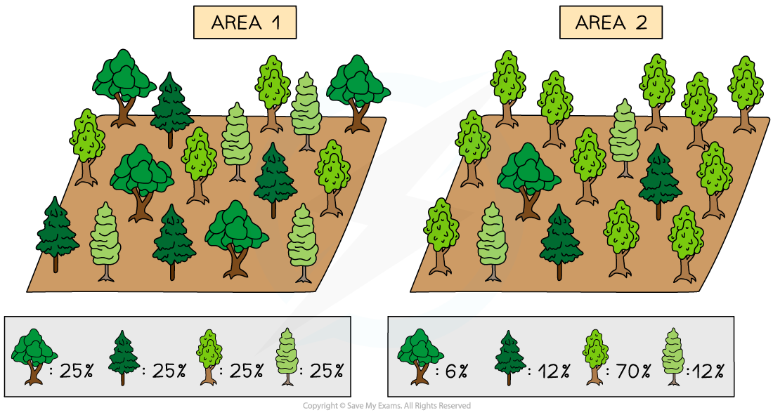

The Calculation of Species Diversity Question
Describe how you would carry out an investigation to calculate species diversity in two different habitats.
____________________________________________________________________________________________________________________________________________________________________________________________________________________________________________________________________________________________________________________________________________________________________________________________________________________________________________________________________________________________________________________________________________________________________________________
Answer
Video link

