Slide 1
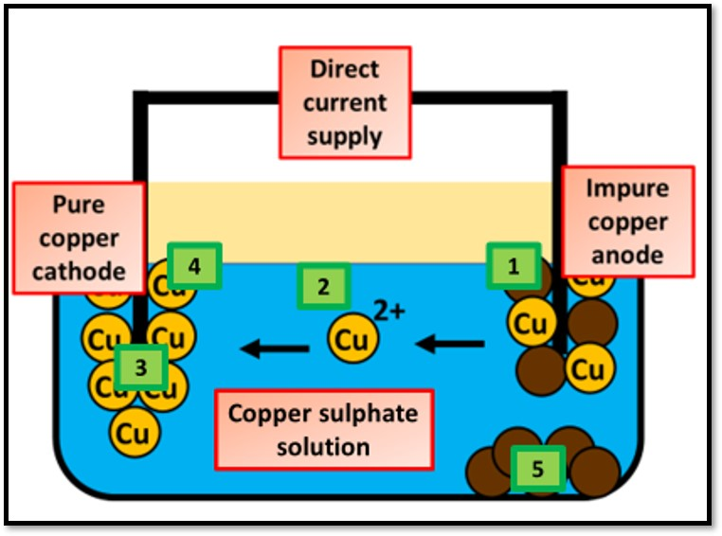
Electrolysis of Copper Sulfate Question
The diagram below shows how an electrolysis practical is set up
Video link
What is formed at the cathode during the electrolysis of copper sulfate?
What is formed at the anode during the electrolysis of copper sulfate?
What is the electrolyte used in the electrolysis of copper sulfate?
Which ion is attracted to the cathode in the electrolysis of copper sulfate?

