Slide 1

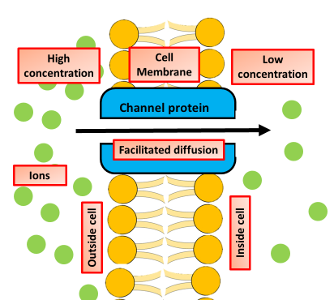

The Great Biology Pubish Quiz
Chemiosmosis

Slide 2

The Great Biology Pubish Quiz
Chemiosmosis
Where does chemiosmosis occur in mitochondria?
A
Matrix
Inner membrane
B
C
Outer membrane
D
Cytoplasm

Slide 3
The Great Biology Pubish Quiz
Chemiosmosis
What molecule provides energy to drive ATP synthesis in chemiosmosis?
A
Oxygen
Proton gradient
B
C
Glucose
D
NADH

Slide 4
The Great Biology Pubish Quiz
Chemiosmosis
Which enzyme catalyzes ATP production during chemiosmosis?
A
ATP synthase
ATP hydrolase
B
C
Dehydrogenase
D
Cytochrome oxidase

Slide 5
The Great Biology Pubish Quiz
Chemiosmosis
What process creates the proton gradient needed for chemiosmosis?
A
Glycolysis
Substrate-level phosphorylation
B
C
Fermentation
D
Electron transport chain

Slide 6
The Great Biology Pubish Quiz
Chemiosmosis
Where do protons accumulate before diffusing through ATP synthase?
A
Cytoplasm
Matrix
B
C
Intermembrane space
D
Cristae

Slide 7
The Great Biology Pubish Quiz
Chemiosmosis
What type of phosphorylation occurs during chemiosmosis?
A
Oxidative
B
Substrate-level
C
Photophosphorylation
D
Reduction

Slide 8

The Great Biology Pubish Quiz
Chemiosmosis
Question 1
B
Question 2
B
Question 3
A
Question 4
D
Question 5
C
Question 6
A

