Slide 1
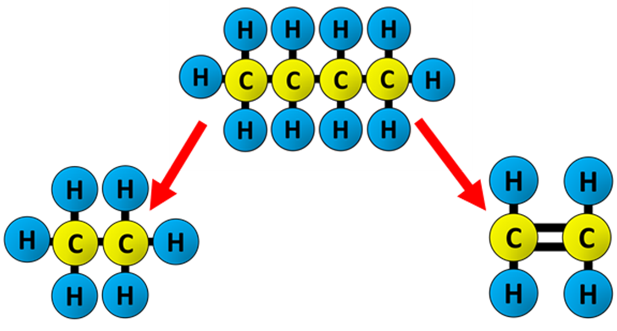
Cracking Question
The diagram shows how alkanes are cracked.
Video link
What is cracking?
What are the two main types of cracking?
What useful product is often made during cracking?
Why is cracking important in industry?

