Slide 1
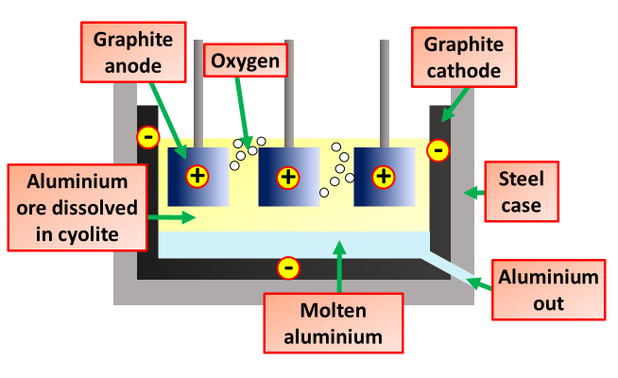

Electrolysis of Aluminium Question
Explain the process of electrolysis of aluminium and the products formed.
Key things to include:
What forms at the cathode
What forms at the anode
How is melting point lowered
_______________________________________________________________________________________________________________________________________________________________________________________________________________________________________________________________________________________________________________________________________________________________________________________________________________________________________
Answer
Link to video

