Slide 1
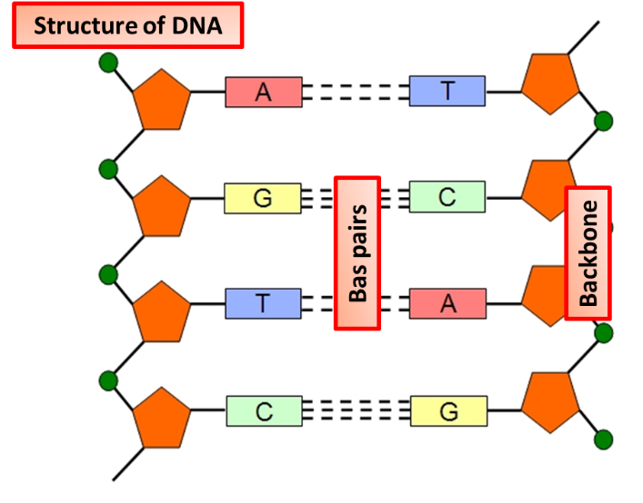
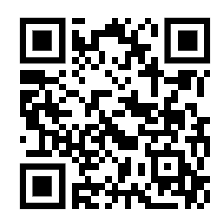
DNA Structure Practice Question
The diagram below shows the structure of DNA.
Describe in detail the structure of DNA and how genes are formed
Key things to include:
What are nucleotides made from
How do bases pair up
How many strands rom DNA
___________________________________________________________________________________________________________________________________________________________________________________________________________________________________________________________________________________________________________________________________________________________________________________________________________________________________________________________________________________________________________________________________________________________________________________________________________________________________
Answer
Link to video

Slide 2
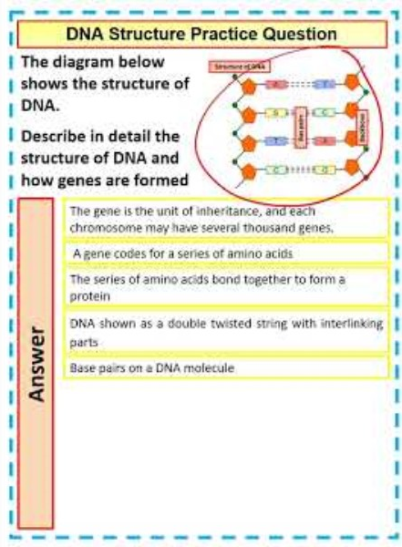
DNA Structure Practice Question

Slide 3

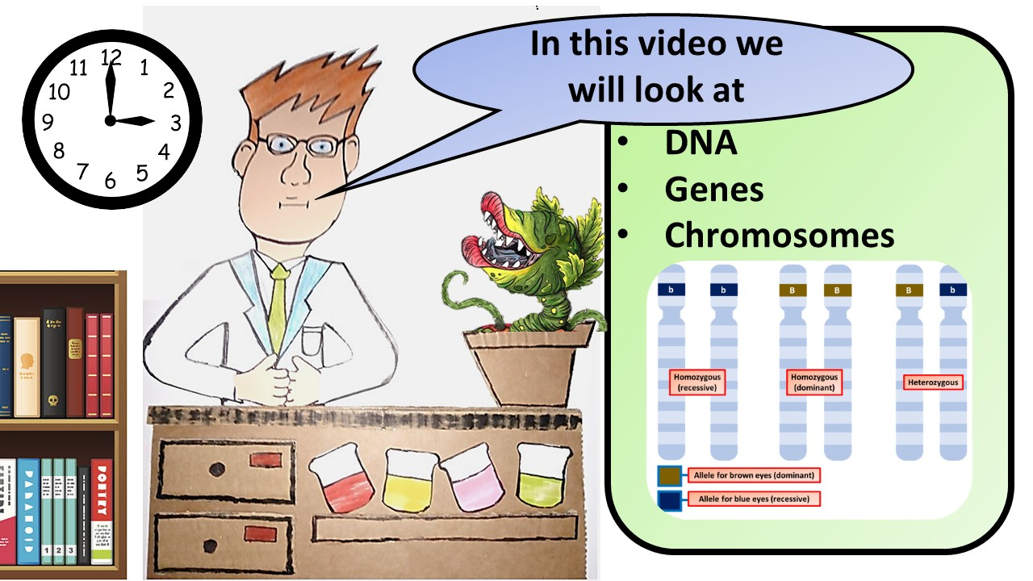


Click here to access my youtube videos
Resources that this activity would work well with
Lesson on TES
Lesson on TPT
Follow me on social media to stay in touch
Keep up to date with my new content:

