Slide 1
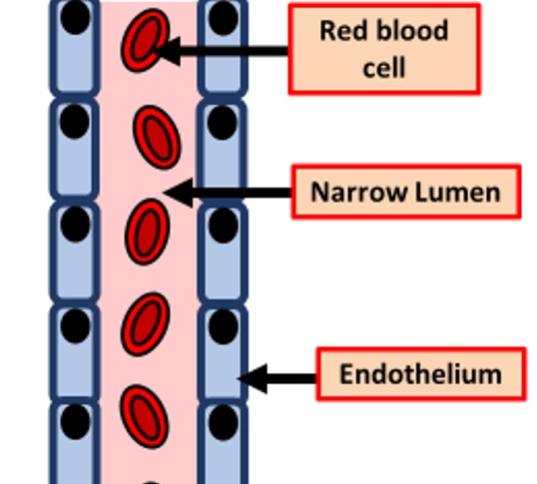

Capillary Question
The diagram below shows the structure of an artery
Explain how capillaries are adapted to their function of exchanging substances between the blood and tissues
________________________________________________________________________________________________________________________________________________________________________________________________________________________________________________________________________________________________________________________________________________________________________________________________________________________________________________________________________________________________________________________________________________________________________________________________________________________________________________________________________________________________________________________________________________________________________________
Answer
Link to video

