Slide 1
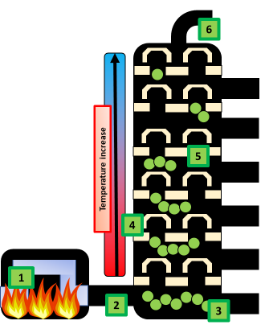

Fractional Distillation Question
The diagram shows the process of fractional distillation
Video link
What is fractional distillation used for?
What is crude oil separated into during fractional distillation?
Which fraction evaporates first in fractional distillation?
Why do different substances in crude oil separate in a fractionating column?

