Slide 1
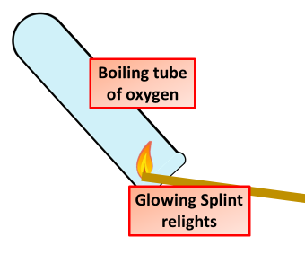

Testing for Oxygen Question
Describe how to test for oxygen gas and the expected result.
______________________________________________________________________________________________________________________________________________________________________________________________________________________________________________________________________________________________________________________________________________________________________________________________________________________________________________________________________________
Answer
Link to video

