Slide 1
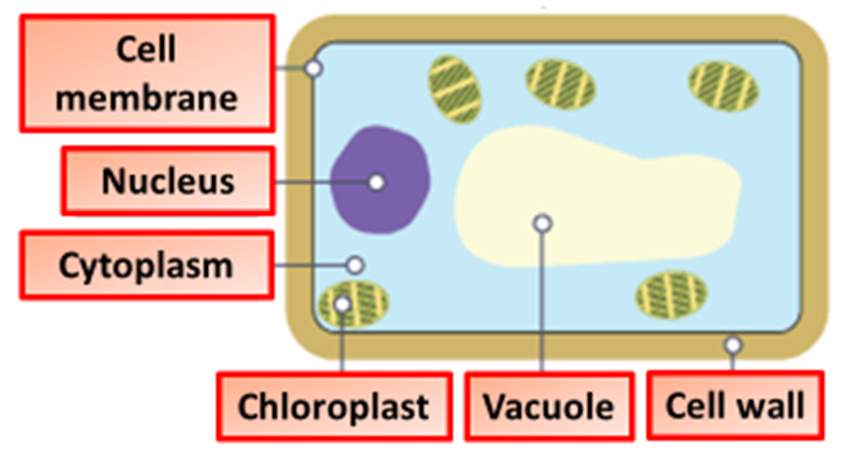
Cells Practice Question
The diagram below shows the sub-cellular structures found in plant & animal cell
State and describe the role of the main organelles found in plant and animals cells or both
Key things to include:
The roles of different organelles including:
Nucleus, mitochondria, vacuole, ribosomes, cell wall
cell membrane, chloroplast, cytoplasm
______________________________________________________________________________________________________________________________________________________________________________________________________________________________________________________________________________________________________________________________________________________________________________________________________________________________________________________________________________________
Answer
Link to video

Slide 2

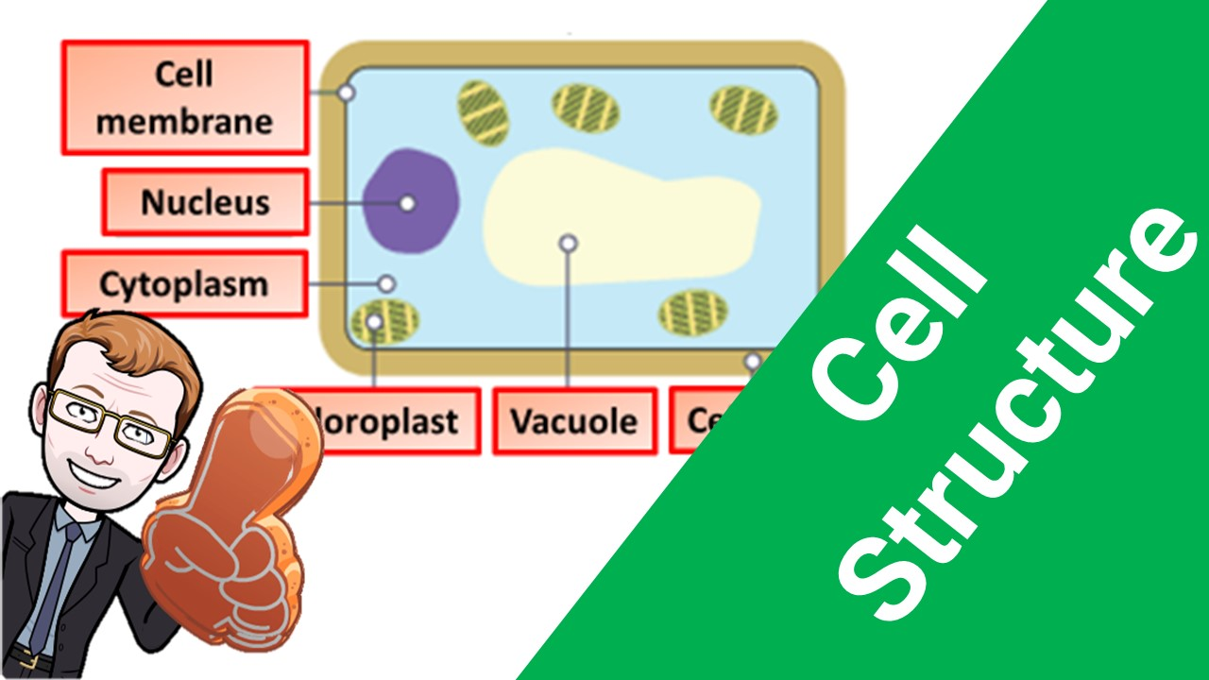


Click here to access my Cells youtube videos
Resources that this activity would work well with
Lessons on TES
Lessons on TPT
Follow me on social media to stay in touch
Keep up to date with my new content:

