Slide 1
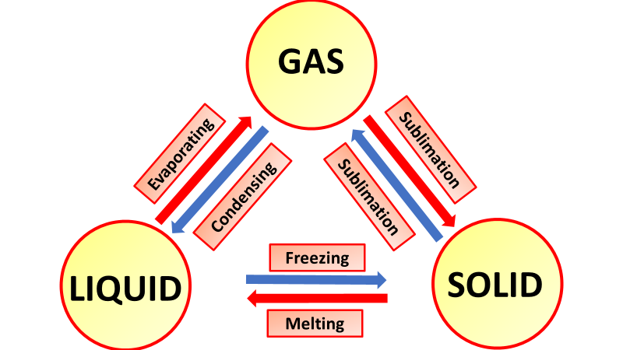

Change of State Question
The diagram below shows changes state from a solid to a liquid and from a liquid to a gas.
Mark Scheme
What is the name of the change from solid to liquid?
What is the name of the change from liquid to gas?
What is the name of the change from gas to liquid?
During a change of state, does the temperature of a pure substance stay the same or change?

