Slide 1
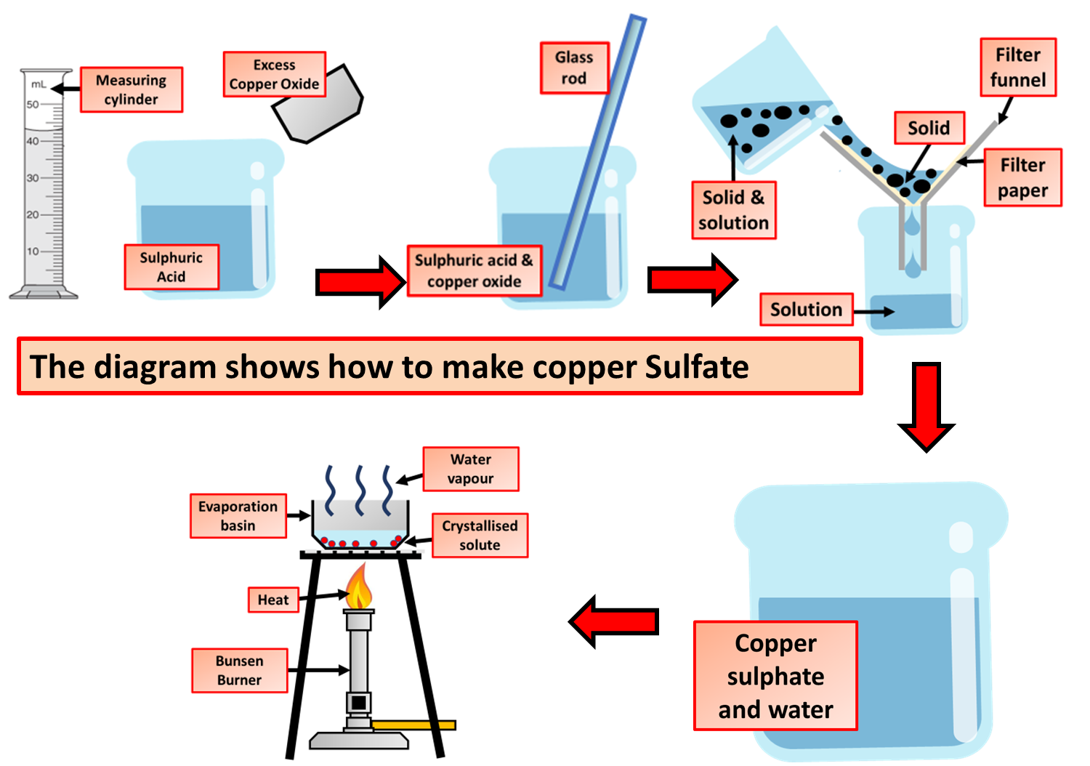

Making Copper Sulfate Question
Video Link
What acid is used to make copper sulfate?
What base is used to make copper sulfate?
What colour is copper sulfate solution?
Why do we filter the mixture after reacting copper oxide with sulfuric acid?

